Slide 1
Secure Remote Access Platform
High-Security Remote Access, Diagnostics, and Monitoring.
Notes:
Introduction
Welcome
My name is
Stephane & Andy
Ask question Q&A tool - Answer Question at the end of the presentation

Slide 2
How we got Here?

Slide 3
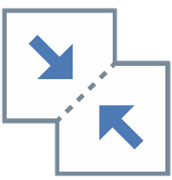
Red Lion’s Expansion into Remote Access
Red Lion has
Best-in-class automation and networking products
Recently lead the industry with an Automation + Networking product line
Long history in remote monitoring and control
Industry leading local protocol conversion

Slide 4
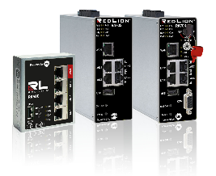
History of Innovation
Secure Remote Access Platform by Red Lion
1972
1976
1993
1998
1999
2004
2004
2013
2018
2020
2020
2020
Red Lion
Founded
End-to-End Process Display
Multi Protocol
HMIs with M2M Capabilities
Ethernet Enabled I/O
Operations to Enterprise Industrial Networking
Ruggedized Cellular
Routers
Universal Protocol Conversion
Hardened Modular HMIs
Effortless
IIoT
Anything In.
Anything Out.
Anywhere.
Gigabit Profinet switch
Secure Remote Access Platform
Industrial Remote Access experience
Notes:
RL has been selling remote access for years but the one component that’s been missing is an RL managed remote access server. Customers find it too much of a hassle to manage their own servers. RL gives them a remote access solution with a complete IIoT solution.

Slide 5
Remote Access Solutions
Customer Challenges
Notes:
In this section I am going to explain you the different customers challenges we have been able to identify by talking to them.

Slide 6
Challenge
Reduce onsite intervention cost and risk
“Onsite maintenance and commissioning is very expensive and risky. I need to optimize and protect the technicians by using remote access capabilities. However, my team has limited skills in networking.
I need a remote access tool, easy to install, requiring no special networking skills.”
Notes:
We met customers who understand the advantages of putting in place a Remote Access solution on their installation. They see the possibility to reduce cost and risk while providing a better service.
However, their expertise isn’t connectivity. There are afraid about investing in a solution too complex to install and maintain.

Slide 7
Challenge
Improve revenues by extending services offer
“ Our market is very competitive reducing our margin to the minimum. To keep our revenues, we are planning to propose to our customers more services around our traditional offer.
We are interested by a solution providing live and logged data of the process to achieve this project.”
Notes:
We met customers who wants develop services, such machine leasing or maintenance contracts, around their traditional offer to increase their revenu. These companies looks for a solution able to provide this data out of the machine.

Slide 8
Challenge
Cyber secured remote access
“Until recently, the security standards for remote access solutions were not important for our customers. Today, in the age of cybersecurity, only remote access solutions with the highest security standards are accepted.
We are looking for a partner capable of providing support and a solution with an maximum long-term security following the latest networking requirements.”
Notes:
We met customers who are challenged with the new restrictive cybersecurity rules in place on their customers site. It requires more and more networking security skill set and exceed their internal competences. They are looking for a long term confident solution and partner which can support them in this task.

Slide 9
Challenge
Reliability in industrial environments
Reduce down time risk is a priority in industry.
Industrial applications need industrial-grade devices for reliability and stability of their electronic assets, especially in harsh environments.
Notes:
The Industrial environments challenge is a common characteristic for all these customers. They all want a solution designed for supporting its extreme conditions 24/7 during years without problems.

Slide 10
Remote Access
The Remote Access Solution
Notes:
In this section I am going to introduce you about the Remote Access solution concept.

Slide 11
What Does Remote Access is designed for?
The ability to remotely and securely:
Securely configure remote systems
Monitor systems and assets
Troubleshoot equipment
Instantly connect to remote devices
Notes:
The remote access solution has been designed to help customers connect to remote devices easily and instantly. Even without deep networking skills and in few minutes, the customers is able to connect to any remote machine securely. Having this connection done, it will be able to configure remote systems, monitor remote installations and its devices while making troubleshooting if needed.

Slide 12
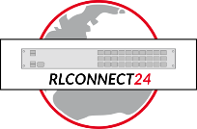
What Does Remote Access Offer?
Secure Remote Access
Connect in 90 sec
Third party VPN services compatible
Wired, Wi-Fi, 3G, 4G
Access from smartphone
Access any communicating device
Access from anywhere
Secure Industrial IoT
Data collection
Data Logging
Dashboard
OT protocols
Alarm Notification
Cloud protocols
Cybersecurity
Firewall
User access management
Keyed security
Easy firmware update
Notes:
Here you can see more in details the tools offered by the Remote Access solution. If we start with the Secure Remote Access part you can see that is possible to connect any communicating device in 90 sec from anywhere even with a smartphone. It can adapt to any available network and it is open to third party devices.
Then on the right, it is all about the Secure Industrial Iot. As you can see it includes a perfect package to integrate the remote systems in a IIoT strategy project.
Last but not least, the cybersecurity tools set. It is the main concern of most of customers and the Remote Access offer protection and advanced management for a long term protection

Slide 13
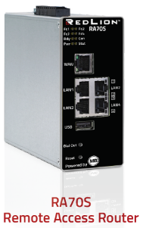
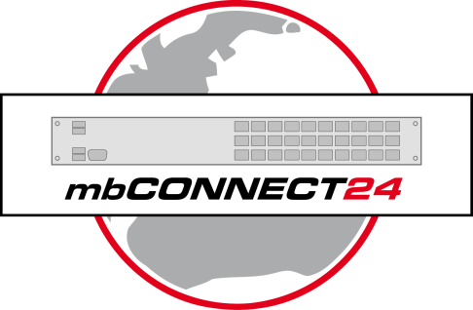
What Does Remote Access Components Do?
Red Lion Remote Access Software
RLDIALUP
RLCONNECT24
Secure Cloud Portal that coordinates Devices and Users
Cloud-based Device Manager (RA products)
Data logging
Data visualisation
VPN client for PC
Establishes secure connection to/through RLConnect24 to Remote Access router
Enables maintenance via native software
Fast deployment via phone, tablet, or PC
QR codes quickly enable remote access
Notes:
The Remote Access is a 3 assets solution. RLConnect24 is the central one. It is the secure cloud that coordinates Devices and users while managing the devices. It also offers dashboards and data logging to make a IIoT solution.
In the middle it is the RLDIalup. This is a software you install on the computer you want to connect securely the remote device from.
On the left, It is the router device. It is the device you install on the field and you connect the remote devices to. It is very easy to install in 90 sec with the simply.connect QR code process.

Slide 14
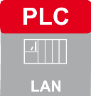
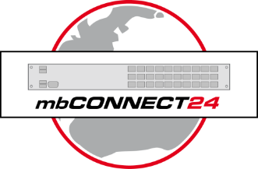
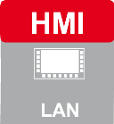
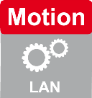
What Does Remote Access works?
Example of Remote Access
RLDIALUP
RLCONNECT24
Notes:
Here it is a basic example how the different Remote Access components work together. On the left, you can see the different devices on the installation to contact. They are connected to the router device which protect them from the external network with the firewall. The RLConnect24 connects securely the computer and the Router device. The Router gives the computer access to the remote devices according the user rightsFron RLConnect24 portal it is possible access to the dashboard and the logs to monitor the installation.

Slide 15
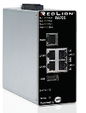
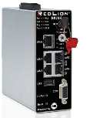
Remote Access and Data Collection Equipment
 | RA50C – Compact Remote Access Router | RA70S - Remote Access Router | RA70K – Keyed Remote Access Router
Operation
Remote Access | Y | Y | Y
Data Monitoring | - | Y | Y
Keyed Security Operation | - | - | Y
Physical Connectivity
Integrated Ethernet Switch | 3-Ports | 4-Ports | 4-Ports
WAN Ethernet Port | Y | Y | Y
Wi-Fi Communication | Opt. | - | -
Cellular Communication | Opt. | Opt. | Opt.
Serial Communication | - | - | Opt.
Tunnel/Security
RLConnect24 | Y | Y | Y
OpenVPN | Y | Y | Y
Ipsec, L2TP,PPTP | - | Y | Y
SIMPLY.connect | *Coming Soon | Y | Y
Notes:
The Remote Access router range offers a variety of 3 models. The RA50C compact model with 3 ports integrated Ethernet switch. It also supports Wi-Fi client and cellular connections.
If you choose the RA70S, you will enjoy the Data Monitoring, the simply.connect features and advanced networking features. The RA70K is the most secured router. It offers a real key on the device that the customer on site use to authorize remote connection to the machine. Simply.connect and serial communication are also part of the package.

Slide 16
Remote Access Product Portfolio
Products, Licenses
Part Number | Description
RA10C000000000DA | Compact Intelligent Firewall
RA50CR0000R000DA | Compact Remote Access Router LAN/WAN
RA50CR0W00R000DA | Compact Remote Access Router Wi-Fi
RA50CR4A00R000DA | Compact Remote Access Router 4G Cellular
RA70KR0000V1S0DA | Keyed Remote Access Router LAN/WAN
RA70KR0010V1S0DA | Keyed Remote Access Router Serial
RA70KR4A00V1S0DA | Keyed Remote Access Router 4G Cellular
RA70SR0000V0S0DA | Remote Access Router LAN/WAN
RA70SR4A00V1S0DA | Remote Access Router 4G Cellular
Products
Part Number | Description
RAC24–x | RLConnect24 Customer Account
RAC24-ACC-ADV-x | Advanced User Access Control
RAC24-ALARM-x | Additional Alarm Events (250)
RAC24-AVPN-x | Additional Active VPN Connection (1)
RAC24-DASH-x | Additional Dashboards (50)
RAC24-DATA-x | Data Consumption Upgrade (2 GB)
RAC24-VPNC | Standard VPN Clients (10)
RAC24-W2G-x | Unlimited Web2Go Connections
Licenses
RLCONNECT24
*Licenses are prorated in year 1, requires full 2nd year
-x represents remaining full months in year 1
Notes:
Here it is what you will find in the Price list. About the products you can see the different versions with their different options. Another point, the EU version of the router finishes by a A when the North American version finishes by a 0.
About the licences, Remote Access has a free basic offer but It is possible to extend its power by buying licenses. You can for example increase the user access control and add Alarm events or dashboards. If you need more details about it just contact us.
This is the end of this section. Do you have any question and is the concept clear for everyone?

Slide 17
Remote Access
Application Examples
Notes:
In this section, I am going to present with some application example in real applications.

Slide 18
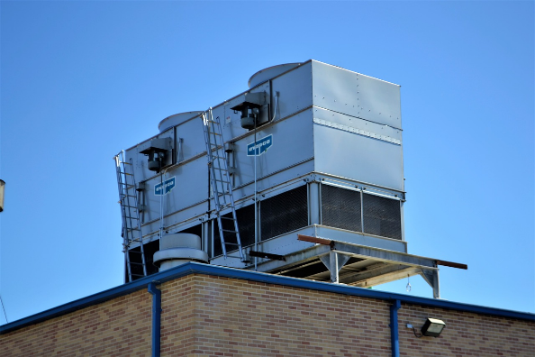
Building automation - HVAC
Remote maintenance and Monitoring
Customer gain
Remote tuning
24/7 monitoring
Services offer
Key benefits
Variety connectivity solution
Security by design
User access control included
Notes:
This example is about HVAC. Most of the time these machines are difficult to reach and can consumed a lot of energy when they are not tuned correctly. Our remote access solution is perfect if this type of challenge. It can easily connect to the internet using the 4G while adapting to new and previous HVAC generations with the different communication interfaces. The manufacturer will be able to offer secure remote tuning and monitoring as service to its customers. This situation can be reproduce with a lot of other similar autonomous machines such as building heater, pumps, valves, etc

Slide 19
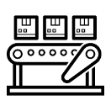
Machine builders - Multi-Location Deployment
Remote support & maintenance
Internet
SITE 1
Site network firewall
Key benefits
No initial investment
Free base service
Grow as you need
Security by design
User access control included
HW & SW customization
SITE 2
Site network firewall
Notes:
Here see how a machine-builder can connect its machines even if they are deployed in various customers site. It will then able to support its customers more efficiently during troubleshooting or tuning activities. The basic Remote access offers all tools to enable it out of the box

Slide 20
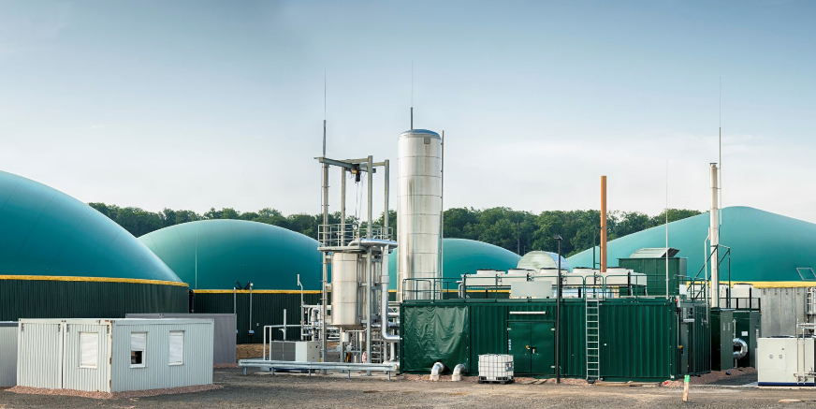
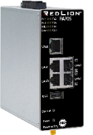
Solution Integrators - Renewable energy process assets
Secure maintenance and monitoring
System Integrator
Basic Ethernet skills
Need to reduce commissioning cost
Need to optimize engineer resources
Need to improve support quality
Sales Drivers
Easy to install
Data logging
Alarm notification
Wireless communication
Security
User based access control
Internet
Notes:
For similar reasons as the Machine builders, solution providers or system integrators needs to access remotely to installations. The Remote Access can be use on machine but also on bigger installation such as renewable energy installations. It will also be able to offer to its customer more monitoring services such as network intrusion protection, Live notifications and dashboards.

Slide 21
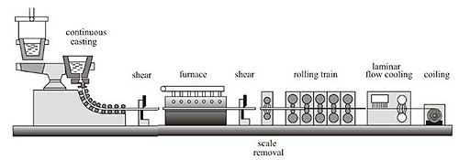
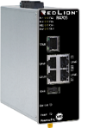
Connect Process line assets
Basic connection strategy
OEM DNA
Process Line portfolio
Basic Ethernet skills
Sales Driver
Ease of use
IIoT solutions
Industrial-rate
Internet
Notes:
The Remote Access solution can adapte to production line. Just by connected it to its network, it is possible to access to any assets connected to it even if there is a firewall protection. Since IIoT features are included, the customer will be able, just by installing the device, to integrate the system into its IIoT strategy.

Slide 22
Connect Process line assets
Network segregation strategy
OEM DNA
Process Line portfolio
Basic Ethernet skills
Sales Driver
Ease of use
More secure and control
Internet
Notes:
Here it is a more advanced example, when talking about big production line network, segregating a network decrease the cyberattack consequences and increase the network efficiency. The Remote access router can segregate the network while the Remote Access solution keeps offering all features described before in the presentation.
It is the end of this section. Do you have any question or other example suggestions?

Slide 23
Remote Access
Positioning and Sales
Notes:
From here I am going to the describe how this solution is on the market. The inputs have been collected from US team, MBConnect experiences and market researches.

Slide 24
Markets
Profile | Market | Sales drivers
OEM – Repetitive machine builder (Green field) | Manufacturing (packaging) Building automation Farming | Secure Remote Access Remote Diagnostic Firmware updating of equipment
OEM - Special machine builders (Green field) | Manufacturing Renewable Energy Utilities Infrastructure Oil and Gas | Secure Remote Access Remote Diagnostic Firmware updating of equipment Fine tuning of access to certain features by user Secure Industrial IoT Warranty services New revenue streams with services
Solution/System integrators (Brown field) | Manufacturing Renewable Energy Utilities Infrastructure Oil and Gas | Secure Remote Access Remote Diagnostic Firmware updating of equipment Fine tuning of access to certain features by user Secure Industrial IoT Warranty services New revenue streams with services Centralized SCADA operations
Notes:
The solution mostly fits for these 3 types of customers.
There are the machine builders. You will find them in Manufacturing, building automation and Farming. In general they are interested by the secure remote Access features for machine troubleshooting.
The OEM and advanced machine builders are in manufacturing, renewable energy, Utilities, infrastructure, Oil and Gas. They are interested by Secure Remote Access to troubleshoot machines and Industrial IoT to offer more services.
There are also the Sytem Integrators. They are in the same markets as the OEM advances machine builders. They are also interested by Secure Remote Access to troubleshoot machines, Industrial IoT to offer more services and centralized data on a SCADA to get a system overview.

Slide 25
Sales strategy
Profile | Audience | Strategies
OEM - Repetitive Machine builder | OT - Service Manager OT - Support Engineer OT - Current Ewon customers R&D project manager IoT, IT/OT | Low margin buisness - focus on cross selling Door opener to promote Crimson and networking solutions
OEM -Special machine builders Solution/System integrators | OT - Service Manager OT - Support Engineer OT - Network Engineer OT/IoT - Project manager OT/IT - Current Ewon customers IT - Department | Door opener to develop those type of customers Door opener to promote Crimson and networking solutions Offer Packaged remote access to a project requiring Crimson solution Phase 2 – Project approach only with focus on IT
Notes:
In this table you can see the people profile interested by this type of solution.

Slide 26
Remote Access
Competition
Notes:
As I told you before in this presentation, the competition on this market is very strong. Here I am going to show where are the Remote Access strenghs.

Slide 30
Cross selling
FlexEdge™ and RA complementary solutions

Slide 31
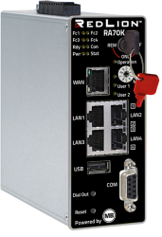
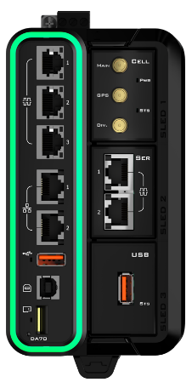
RA50/70 Solution
DA50/70 Solution
Looking for an Easy All-in-One IIoT Solution
Technical Customer
Needing Flexible Options
Simple and scalable secure remote access with Cloud-hosted management
All-in-One Solution offers:
Secure Remote Access
Device Management
Data Acquisition
Data Visualization
Strict user-based access control
Support for several key industrial protocols (~17 drivers)
Anything in, Anything out
300 Protocols with IoT Connectors
Ideal for aggregating data via modular communications:
Cellular, Ethernet, Serial, Wi-Fi, or USB
Remote Access via customer-managed systems – (OpenVPN, GRE, IPsec)
Crimson Control – IEC61131
Certification, Ruggedness
Notes:
I am sure you already realized that the Remote Access and the FlexEdge features can be very close. So what differentiate them. As we just seen the Remote Access solution is designed to offer very simple and scalable secure remote access. It also include good device management, users management and IIoT features. It fits for low technical skilled customers to medium.
The flexEdge is more technical and more flexible. It will be able to achieve more advanced projects and support more reggudised environment.

Slide 32
RLConnect24
All-in-one IIoT Solution with Flexible Communication Options
Quick and easy secure remote access with data acquisition, edge control, and data visualization in one solution
Support for 300+ industrial protocols for local and cloud-based data acquisition
Multiple field communication options via modular sleds
Powerful advanced networking features with Crimson 3.2
On-board or field-installable I/O options
Local and cloud-based visualization
Security in layers
Notes:
Even though the FlexEdge is capable of Easy remote access and centralized monitoring, it cannot be done as easy as the Remote access can do. Some customer appreciate the combination of both.
Welotec is extending its own remote access offer with FlexEdge
MB Connect sees opportunities for the FlexEdge into their solution

Slide 33
How does it work?

Slide 34
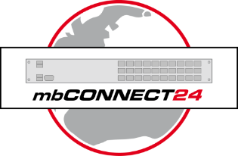
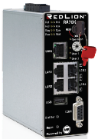
Remote Access Software
RLCONNECT24
Client VPN Software
RLDialUp

Slide 35
What does RLCONNECT24 do?
Central Hub
Interconnect between users and devices
Device Management
Manage firmware, add devices, etc.
Data Visualization
User Management
RLCONNECT24

Slide 36
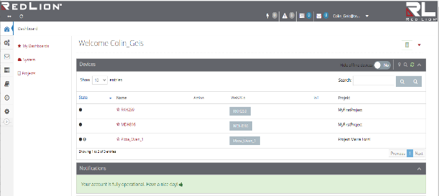
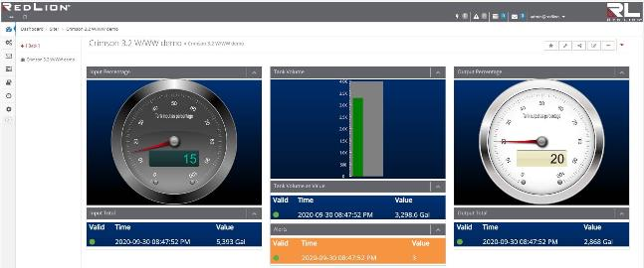
RLCONNECT24 Portal Cont’d
Data Logging & Visualization
Data log operational data
Log on value changes or on intervals
Alarm notifications via email or SMS
Create widgets
Develop custom dashboards
User Management
Manage users or groups of users
Grant access by role
Restrict access to networks, devices, data and/or dashboards

Slide 37
RLDialUp – VPN Client Software
RLDIALUP
RLDialUp is a VPN client software to connect technicians to remote assets to perform remote maintenance.
How it works:
Launch RLDialUp application
Select the device to connect to
Launch configuration software (i.e. Crimson)
VPN
RLCONNECT24

Slide 38
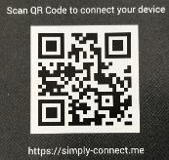
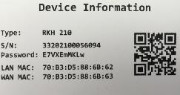
Simply.Connect
Simply.Connect is a technology that can connect a Router in ~90 seconds, in three easy steps:
1.) Log-in to simply-connect.me (or scan QR code)
2.) Scan the QR code in the box
3.) Complete! Simply add a device name
90 seconds

Slide 39
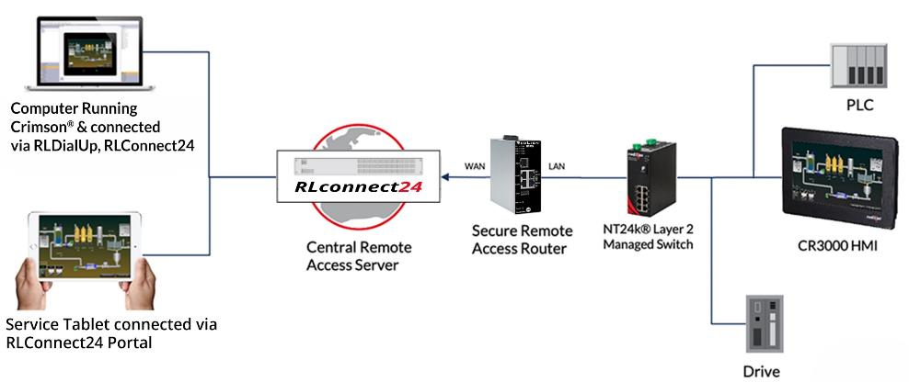
All-In-One IIoT Solution
IIoT Application Diagram Example
Remote Access concept
Remote Application Assets
FlexEdge DA70A
Notes:
Use this application diagram to describe what you’ll be showing the audience in the dashboard demo.
Key points:
VPN tunnel makes it possible to work just as if you were local to do things like view the virtual HMI, make software changes to industrial equipment and troubleshoot issues
2 different ways to consume the data that is at the remote site, VPN connection via RLDialUp & viewing dashboards from browser

Slide 40
Example of Remote Access
Multi-Location
Remote Access
Router VPN
i.e. Port 80
Central Server:
Germany
SITE 1
RLCONNECT24
SITE 2

Slide 41
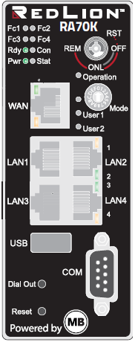
Example of Remote Access
Multi-Location Deployment
SITE 1
RLCONNECT24
Laptop via RLDIALUP Software
SITE 2

Slide 42
Example of Remote Access
Multi-line Deployment
Line 1
RLCONNECT24
Laptop via RLDIALUP Software
Line 2

Slide 43
Remote Access – Scalable
Central Server:
Germany
Easy Expansion
Add new device in minutes
Simply deploy a new Remote Access router, and add it to your account
RLCONNECT24

Slide 44
Remote Access
Launch process and dates

Slide 45
Milestones
29th of June - Public announcement
July – Private promotion sessions on demand (sales contact)
July - Partners technical trainings (sales contact)

Slide 46
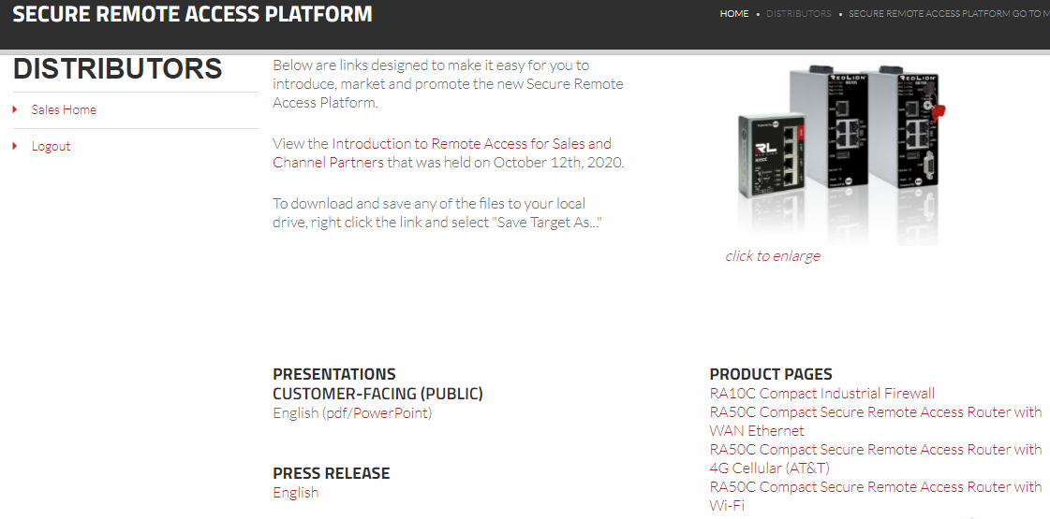
PR and sales material
Available in the web site distributor area
Go to market kit Remote access plateforme
E-Learning platform coming soon

Slide 47
3 Keys to Success
Intuitive, quick and secure remote access
Basic packaged IIoT solution included
Sales target is OEM, Solution and System integrators

