Slide 1
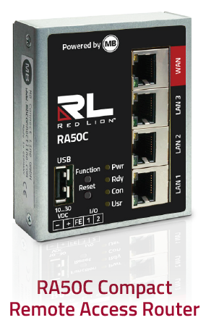
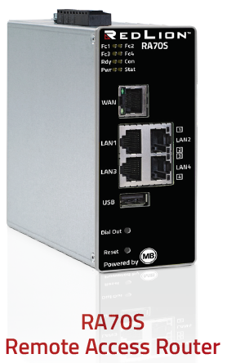
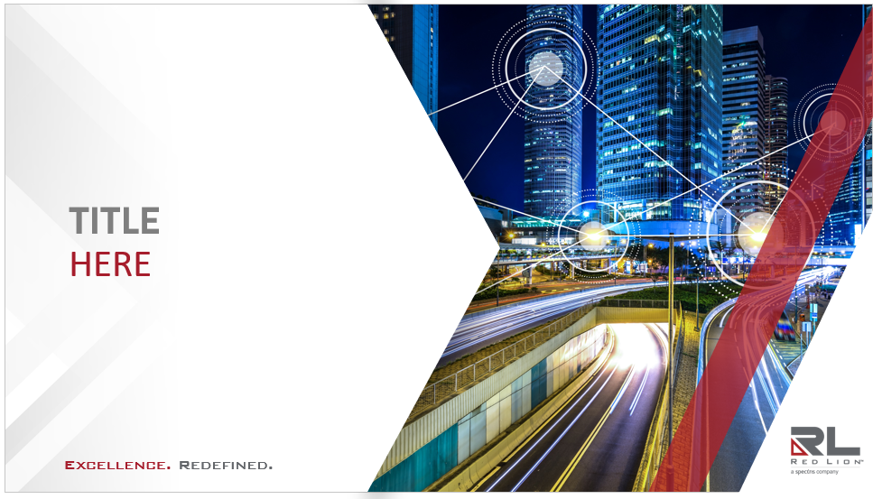
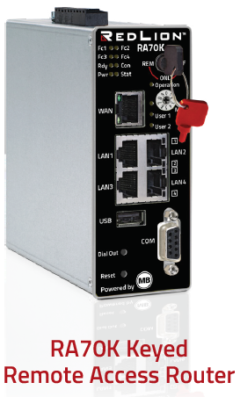
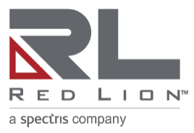
After the first use, if you need to add a new image make sure to right click on the uploaded picture and select “Send To Back”
Red Lion
Remote Access Platform
*Correct use of image layers
Excellence. Redefined.

Slide 2
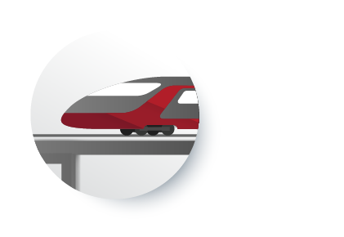
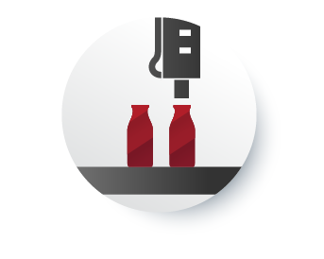
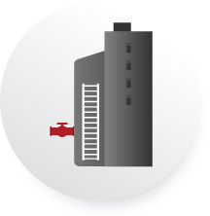
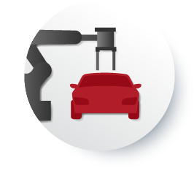
The Challenges of Remote Assets

Slide 3
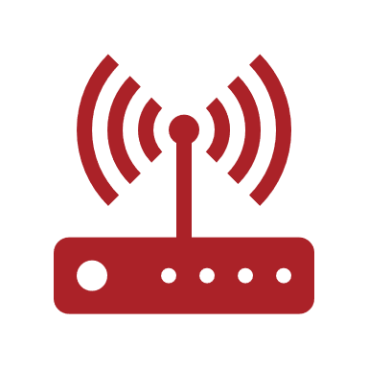
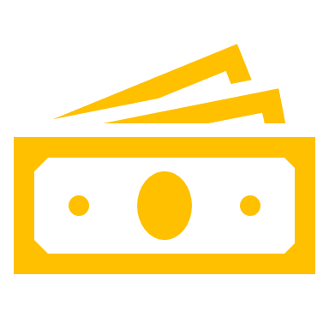
Save time and money on remote access deployment costs
5
$4,116
minutes
70.83 labor hours
x 850 devices
cost to deploy manually
per device to configure manually
SIMPLY.connect offers the customer a savings of over 70% on their remote access deployment costs
Notes:
Competitive deployment method cost $4.84/unit
SIMPLY.connect deployment method cost $1.45/unit

Slide 4
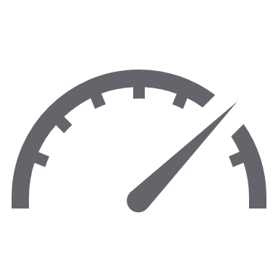
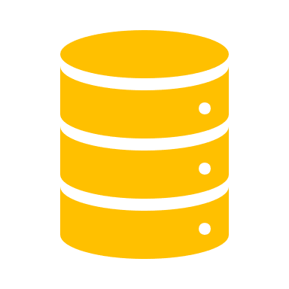
Quickly deploy a complete IIoT solution
50k data tag storage
10 dashboards
10 alarms
devices and users
Customers can go full IIoT in less than 30 minutes with RLConnect24 + RA70
Notes:
With RL RAP a customer can go from isolated automation and process control application to full IIoT in minutes

Slide 5
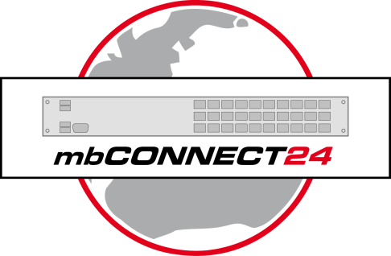
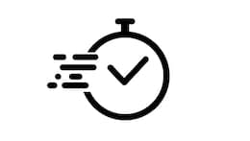
Components
RLDIALUP
RLCONNECT24
Cloud Portal
Central Point coordinates users and Remote Access routers
Cloud-based Device Manager (RA products)
Data logging & Dashboarding
VPN client for PC
Establishes secure connection through RLConnect24 to Remote Access router
Enables maintenance via native software
Fast deployment via phone, tablet, or PC
QR codes quickly enable remote access
Notes:
RL has been selling remote access for years but the one component that’s been missing is an RL managed remote access server. Customers find it too much of a hassle to manage their own servers. RL gives them a remote access solution with a complete IIoT solution.

Slide 6
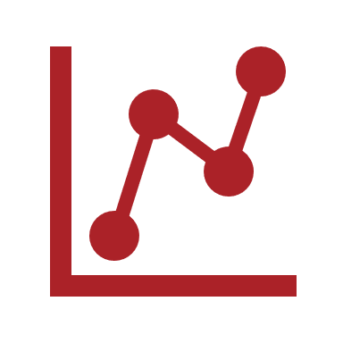
RLConnect24 Customer Account
Feature | Complimentary | Additional Features
 | Quantity | Quantity* | Part Number
Number of accounts | 1
Number of devices & projects | Unlimited
Number of users | Unlimited
Number of standard VPN Clients(3rd party devices) | 0 | 10 | RAC24VPNC
Data points (tags) per device | 250
Number of VPN connections at one time to a single RA50/70 | 1 | 1 | RAC24AVPN
Dashboards | 10 | 50 | RAC24DASH
Alarms | 10 | 250 | RAC24ALARM
Number of WEB2go connections | 5 | Unlimited | RAC24W2G
Data Consumption Upgrade/Month | 2GB | 2GB | RAC24-DATA
RLCONNECT24
^{*additional quantities} ^{available in increments}
^{noted above.}
Notes:
1 free account per customer
The account name is tied to the customer’s domain name
* means that the feature can be increased by purchasing a license.

Slide 7
Remote Access and Data Collection Equipment
RA50C – Compact Remote Access Router
Establishes a secured connection to RLCONNECT24
Easy to deploy in volume
Available with Ethernet, Wi-Fi, or Cellular
Compact metal case with DIN connector
RA70S - Remote Access Router
Remote Access and Data/Alarm Monitoring
SIMPLY.connect (3-Step provisioning)
Available with Ethernet or Cellular
Widgets and Dashboards available
Metal case with DIN connector
RA70K – Keyed Remote Access Router
Establishes a secured network with our central server
User control of connectivity via a key switch
Available with Ethernet, Serial, or Cellular
Widgets and Dashboards available
Compact metal case with DIN connector

Slide 8
Remote Access and Data Collection Equipment
 | RA50C | RA70S | RA70K
Operation
Remote Access | Y | Y | Y
Data Monitoring | - | Y | Y
Keyed Security Operation | - | - | Y
Physical Connectivity
Integrated Ethernet Switch | 3-Ports | 4-Ports | 4-Ports
WAN Ethernet Port | Y | Y | Y
Wi-Fi Communication | Opt. | - | -
Cellular Communication | Opt. | Opt. | Opt.
Serial Communication | - | - | Opt.
Tunnel/Security
RLConnect24 | Y | Y | Y
OpenVPN | Y | Y | Y
Ipsec, L2TP,PPTP | - | Y* | Y
SIMPLY.connect | - | Y | Y

Slide 9
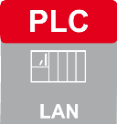
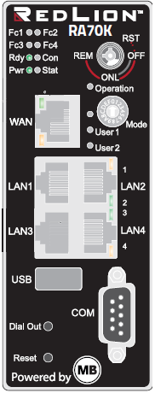
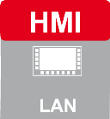
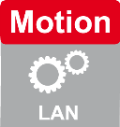
Example of Remote Access
Multi-Location Deployment
SITE 1
RLCONNECT24
Laptop via RLDIALUP Software
SITE 2

Slide 10
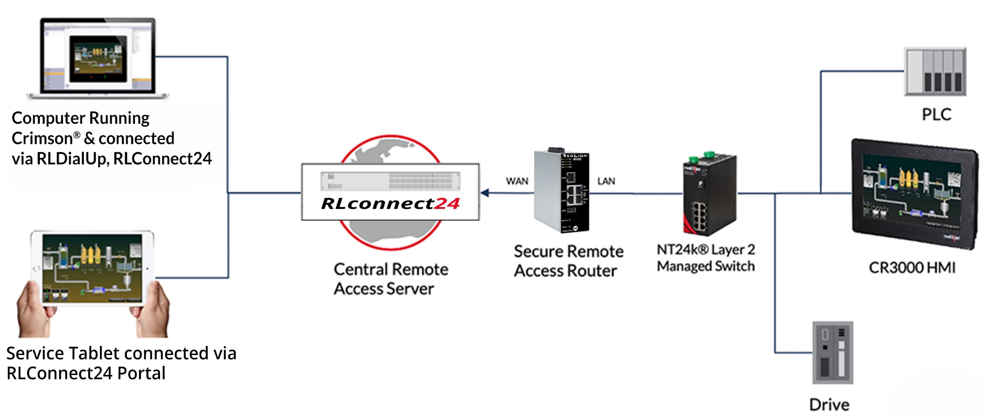
All-in-one IIoT Solution
IIoT Application Diagram

Slide 11
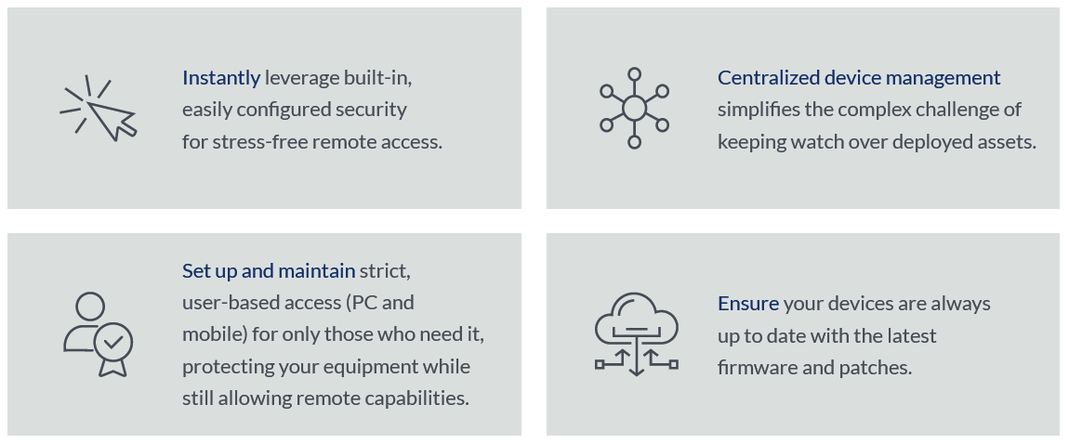
Unyielding Security
built right in

Slide 12
Pricing and Part Numbers
Notes:
SAM/TAM will sharescreen and go over pricing with the channel partner

Slide 13
SIMPLY.connect
Video

Slide 14
Dashboard Demo
walk-thru

