Slide 1





After the first use, if you need to add a new image make sure to right click on the uploaded picture and select “Send To Back”
Five Key Elements of IIoT Implementation
*Correct use of image layers
Name
Title
Excellence. Redefined.

Slide 2
Studies have shown that
74%
…of IoT projects will fail.
Source: IoTWF, May 2017

Slide 3
01
02
03
IIoT is
Everywhere
Establish Your Why
Create a Framework
Determine Your Level
of Data Fluency
04
05
Look for Operational Efficiencies
Secure Your Investment
Choose the Right
Partners
Summary
Notes:
© Copyright Showeet.com

Slide 4









IIoT is Everywhere
Smart Manuf. Leadership Coalition
NNMI (DoE)
Produktion 2030
Made in China 2025
Innovate UK
Make in India
Manufacturing Innovation 3.0
Industrie 4.0
Usine du Futur
Industrial Value Chain Initiative
(IVI)

Slide 5
Establish Your Why
Quality improvement? Margin enhancement?
Knowing what the final picture should look like is critical to success.

Slide 6

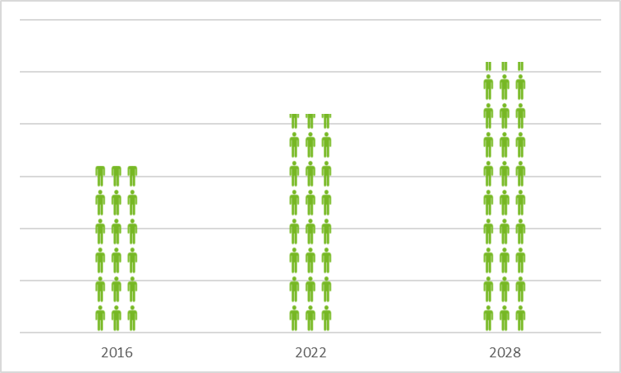
Expansion of the Global Middle Class is Driving Unprecedented Demand
5.2 billion
Middle-class consumers by 2028
$64 trillion
Anticipated annual middle-class
spending by 2030
Source: Brookings Institution

Slide 7







Enhancements Must Deliver
Meaningful Outcomes
Cost and Budget
Data aggregation & analysis enables:
Smart capital expense optimization
Doing the right things with the right amount – replacing “do more with less” mentality
Manufacturing
Yield, energy & throughput analytics enables:
Real-time performance management
Data-enabled predictive maintenance
Zero-based budgeting (ZBB)
Digital
manufacturing
End-to-end digital enablement
Analytics to
value
Customer Journey
Intelligent process automation, robotics and end-to-end digitization of processes enables:
Values-driven changes to be made more quickly, easily & sustainably
Product
Connect new and existing data sources with new technologies enables:
Complexity management
Design-based optimization
R&D productivity through machine learning
Source: McKinsey & Company

Slide 8
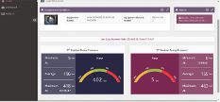
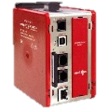

Success Story:
Data Acquisition in Automotive Manufacturing
Situation
An automotive manufacturing plant was planning to increase its output by 30% over the next two years. As a way to increase capacity, they needed to better predict machine maintenance needs and increase uptime, managing over 700 PLCs from five different manufacturers.
Value
RAMQTT made connecting data from the disparate equipment to the Amazon AWS platform simple, enabling Red Lion’s integration partner to deliver a proof of concept in less than two weeks. Due to the modest development costs and resulting high-impact uptime improvement, ROI is estimated to be less than twelve months.
Solution
Red Lion recommended the Modular Controller, a data acquisition system uniquely suited to scaling across multi-vendor, multi-generational systems, and a RAM® Layer 3 router with RAMQTT, Red Lion’s MQTT client with native support for over 11 IIoT platforms.

Slide 9
Establish Your Why: Questions to Ask
Order sizes are shrinking as demands for customization and reduced lead times increase.
Competition is rising and increased pressure to adapt has the potential to jeopardize quality and uptime.
Is my current operation, process or department as efficient as it can be?
Is it capable of consistently running at target capacity?
Are delays and downtime minimal?
Can changeover time be shortened?
Is work scheduled based on demand versus forecast?
For OEMs: Am I spending too much on warranty service & repair?

Slide 10
Create a Framework & Gain Buy-In
With management and across functional groups, define what success looks like.
Notes:
During this phase of the process, think of your work as though you’re a piñata-maker. Be collaborative and divorce ego from what you start with. The best thing you can do is put ideas and structure forward, and prepare for the team to beat it apart – by doing so, together you’ll get to the good stuff.

Slide 11





Deployment Considerations
Pre-Deployment
Deployment
Post-Deployment
Action
Where to?
Connection
Site survey & resource needs
Who owns the problem?
Equipment
What, where, when and why
What exactly is “it”?
Solution
Endpoint
Define expectations
Plan for the inevitable
What’s my support plan?
Can I change providers?
Can you hear me?
Installation
Testing, testing
What’s new?
How will it get there?
What happens if it breaks?

Slide 12

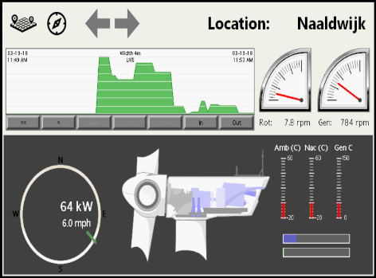
Remote Assets and Product as a Service (PaaS) Strategies Continue to Expand
Analyze historic maintenance data across multiple locations to formulate preventive strategies
  Reduce costs of warranty service and routine service calls
  Increase uptime of assets and reduce maintenance costs by detecting symptoms of potential failures
Enable more effective monitoring and faster optimization by fewer highly-skilled personnel, regardless of location

Slide 13
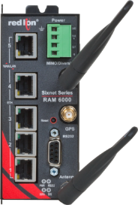
Success Story |Food Waste Management
Situation
A manufacturer of sustainable food waste reclamation equipment needed a way to scale their operation, improving reliability and offering predictive services while keeping costs in check. The system could experience several Gs of force in short bursts, so hardiness & reliability were critical.
Value
Connecting the original Modbus-based prototype to a cloud platform was simple using the RAM-6921’s intuitive RAMQTT GUI. Once the remote data collection systems on each tank were active, the OEM was able to automate dispatch of waste collection trucks and improve tank utilization from 75% to 97%. Site management costs also improved, dropping from 1 customer-service employee per 25 sites to 0.1 employee per 70 sites.
Solution
Red Lion recommended the robust and versatile E3 IO MIX module to connect to their sensors and rugged RAM-6921 cellular RTU with the RAMQTT native MQTT client for point-and-click IIoT cloud connectivity and Event Engine for local control.

Slide 14





Create a Framework: Questions to Ask
Assess Equipment
Protocols & Communication
Location & Environment
Security
Staff
  How old is your equipment?
  Can it communicate with newer technologies?
  How much time and money will it take to connect?
  What cost-effective solutions address this issue?
  How many different protocols are being used?
  Do I want equipment to communicate locally as well as upstream?
  What type of media is being used?
  What cabling must be supported?
  Will devices be monitored via 4G/LTE, fiber or broadband?
  Are there temperature fluctuations?
  High vibration or hazardous chemicals?
  Industry certifications required for operation?
  How can sensitive data be protected as it’s collected and transferred?
  Are there any in-house regulations regarding the protection of data & information?
  What security measures are already in place?
  Is leadership invested in IIoT to help address their business goals?
  Is IT bought in to Operational success?
  Do we have the right skillset in-house for planning, installation & monitoring?

Slide 15
Determine Your Organization’s Level of Data Fluency
Use products that give you the freedom to select the best systems to drive innovation.

Slide 16
Connecting Devices is Easier Said than Done
59%
Industrial CxOs who believe cognitive computing, big data & AI are mature & market-ready
100+
Average number of software applications running in a manufacturing site
77%
Nexus survey respondents who said interoperability was their biggest challenge in IIoT
Source: IBM & Nexus

Slide 17







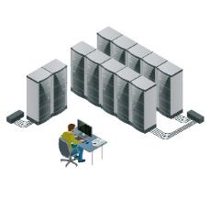















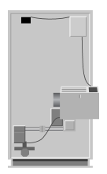


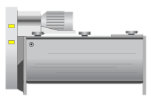
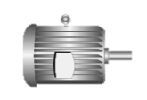
The Language of the IIoT is Diverse and Evolving
IIoT Connectivity
MES, ERP, SCADA Systems
Industrial protocol conversion, data aggregation, synchronization, edge computing, OEE analytics
Machine 1
Built 2012
PLC with Ethernet
Sensors
(temp, level, pressure, vibration, flow, etc.)
Machine 2
Built 1999
PLC with serial interface
Machine 3
Built 1994
µC + drive controllers
Machine 4
Built 2002
PLC with CAN
Building data
(power, air, heat, etc.)

Slide 18

MQTT: A Publish/Subscribe Model
Client
Any device that has an MQTT library running and is connecting to an MQTT broker over any kind of network.
Broker
Responsible for receiving all messages, filtering them, deciding who is interested and then publishing the message to all the subscribed clients.
IIoT Platform
Connects the data received to services & other devices, secures the data, can process & act upon the data.
CAUTION: One IIoT platform’s MQTT is not the same as the next.

Slide 19











Increasing Data Fluency in Your Organization
Inspect
Include
Take an inventory of the protocols, media types and applications used in your operation. Are there orphaned devices?
Bring together people from every level of your department and across organizations. Understand how data flows up and downstream today.
Question
Gather
Data
Fluency
When considering new equipment, does it have built-in support for industrial and IIoT connectivity? How easy is it to configure or change?
Conduct brainwriting sessions and gather the results you want to see into affinity groups, by purpose, or source, or business unit need.
Connect
Iterate
Consider how and where you want to connect with your information. Bring IT into meetings with carriers or cloud providers for their perspective.
Make data fluency a part of your continuous improvement process. When choosing hardware or partners, understand what is impacted if there are changes later on.
Notes:
© Copyright Showeet.com – Creative & Free PowerPoint Templates

Slide 20
Increase Operational Efficiency
Not everything in IIoT is “out there.” Address intermittent inefficiencies
and improve output right now.

Slide 21

Source: imgflip.com

Slide 22
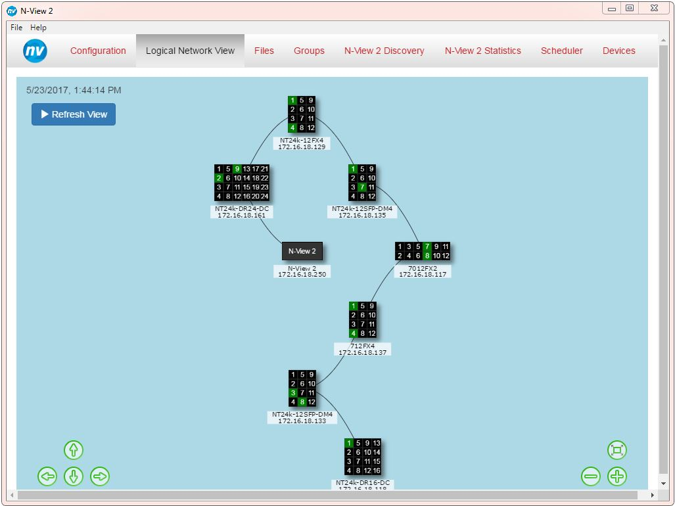
Make the Move to Managed Switches
When it’s important to have input and control over traffic on the LAN, it’s time to move to a managed switch.
Managed switches enable you to:
  Configure settings specific to your needs
  Have control over how data travels and who has access to it
  Detect, diagnose & repair problems
  Monitor switch performance

Slide 23

Key Managed Switch Features
Virtual LAN (VLAN)
Remote Monitoring
Logically group devices together to isolate traffic between them, even when traffic is passing through same switch
Get easy-to-understand information about network devices and real-time alerts when there are problems
Redundancy
Port Mirroring
Safeguard a network in case a connection or cable fails by providing an alternate data path for traffic
Copy & forward network traffic to observe data on other ports or segments without taking the network out of service

Slide 24
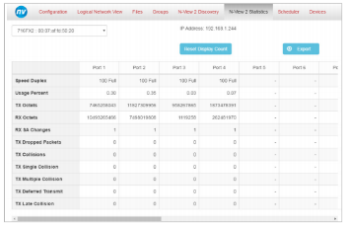
Success Story | Bottling
Situation
A regional bottling facility was experiencing network outages in one area of their plant. Because they were intermittent in nature and would sometimes appear to resolve on their own, the administrator was having difficulty pinpointing cause after several weeks of investigation.
Value
In examining the N-View data, the team quickly saw that there were dropped receive packets, FCS errors and symbol errors on one of the ring ports – all indicative of a possible cabling issue.
Within minutes, they changed out the cable and restarted the
switch. The customer has since reported that the intermittent issue has been resolved – saving hours of uptime, and thousands of dollars, as a result.
Solution
Red Lion’s technical team arrived on site and discovered that while the customer was using N-Tron Series managed switches from Red Lion, they hadn’t been using the N-View functionality to diagnose the issue.

Slide 25
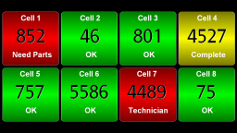
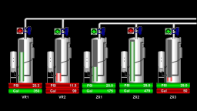
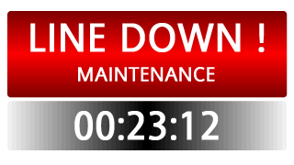
Connect Operators to Organizational Goals with Key Performance Indicators (KPIs)
Although changing from a reactive to proactive culture is difficult, it is achievable. It requires monitoring and rewarding operating activities aligned with organizational policies.
Count & Reject Ratio
Takt Time
Target
Downtime
OEE
Many companies
will compare individual worker and shift output to invoke a
competitive spirit among employees.
Takt time is the amount of time required for the completion of a task or the cycle time of a specific operation.
Display target values for output, rate, takt time and quality. This KPI helps motivate employees to meet specific performance targets.
Whether the result of a breakdown or simply a changeover, downtime is considered one of the most important KPI metrics to track.
OEE is a metric that multiplies availability by performance and
quality to determine utilization. The higher the number, the more efficient the operation.

Slide 26
Secure Your Investment

Slide 27




Simplify & Secure Your Network
Routing Between Subnets
Network Address Translation (NAT)
Maintain clean separation within a network by defining logical boundaries between different functions without significant re-cabling costs
Reduce the amount of broadcast traffic being sent to the entire network
Create easily manageable, repeatable programs that can be used across cells or factories without the need for additional costly PLC network interfaces
Simplify system backup, and add a layer of network security with NAT
Stateful Firewall
Virtual Private Network (VPN)
Enable secure remote access
Allow or block traffic based on state, port, or protocol
Monitor all activity from the opening of a connection until it is closed
Make factory-to-factory, supply chain-to-factory or factory-to-distributor communication secure
Red Lion routers are secure by default – unique password per unit when shipped
Supports 2,048-bit encryption; by comparison, banks typically use 128-bit encryption for web transactions

Slide 28
Pick Products that Comply with
Regulations Important to Your Business
EN61373 Shock and Vibration
EN45545 Fire Safety Certification
FCC
ABS Type Approval for Shipboard Applications
Conformité Européene
Class I Div 2
Hazardous Locations
EN50155/EN50121 Rail Certification
RoHS Compliant
Notes:
Red Lion’s shock and vibration far exceed that of our competitors’ published specs
Also designed to comply with IEEE 1613 (Electric Utility Substations)
NEMA TS1/TS2 (Traffic Control)
.

Slide 29
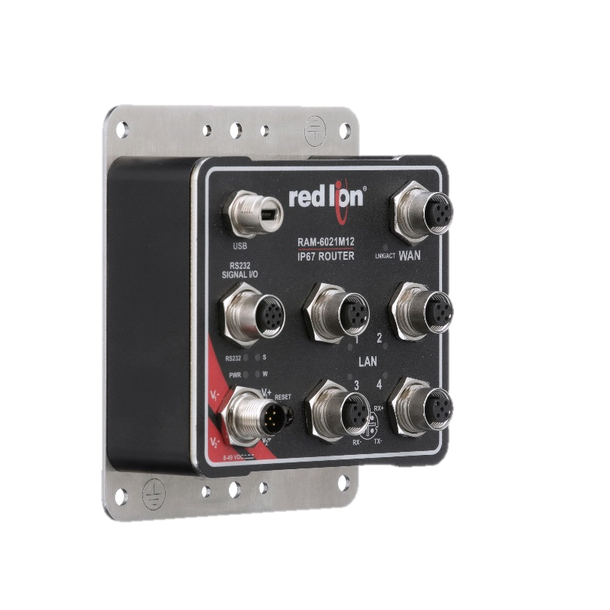
Rugged & Reliable Performance
Choose devices safe to deploy in remote areas and harsh environments
-40 to 80 °C operating temperature
Vibration IEC60068-2-6: 50 g, 5-200 Hz
Shock IEC60068-2-27: 200 g @ 10ms
IP67 Rated
Dustproof, water-resistant design
M12 connectors for exceedingly reliable connectivity
Ideal for extreme conditions
RAM-6021M12 Layer 3 Router
Notes:
The same software features as RAM-6021 in an IP67 rated enclosure ideal for harsh environments.

Slide 30
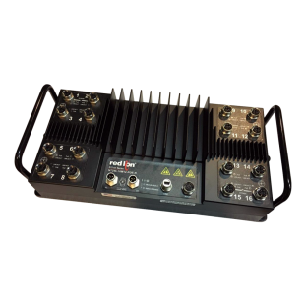
Consider IP67-Rated Devices
Some customers are moving to IP67 options they can mount directly in-cell, versus non-IP67 devices built into custom panels
As a result, the units are:
  Easier to install with reduced wiring
  Easier to access & maintain
And consequently offer them:
  Reduced total system cost
  Reduced downtime when there is a problem
  Reduced total cost of ownership

Slide 31
Choose the Right Partners
And choose solutions that help you select new partners when your needs change.

Slide 32
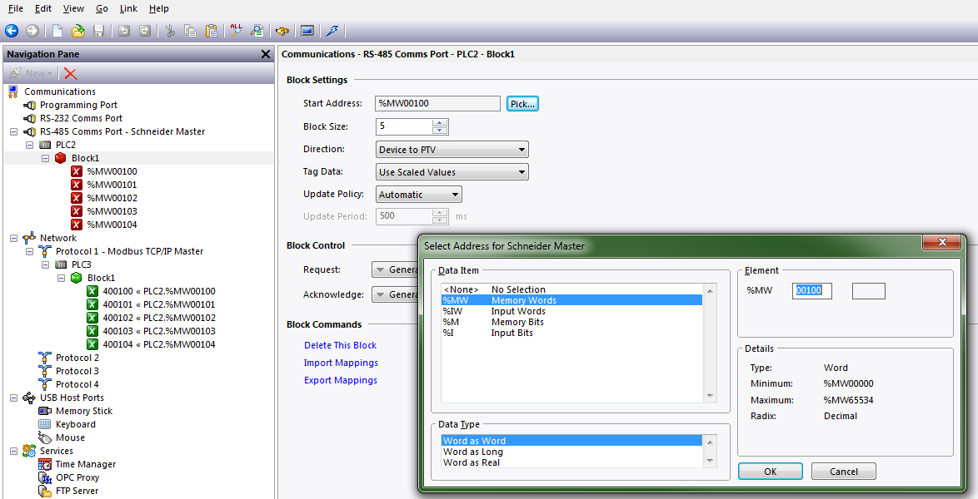
Create Out-of-Box Compatibility with New or Existing Equipment
Built-in support for over 300 industrial drivers ensures equipment remains relevant for years to come

Slide 33
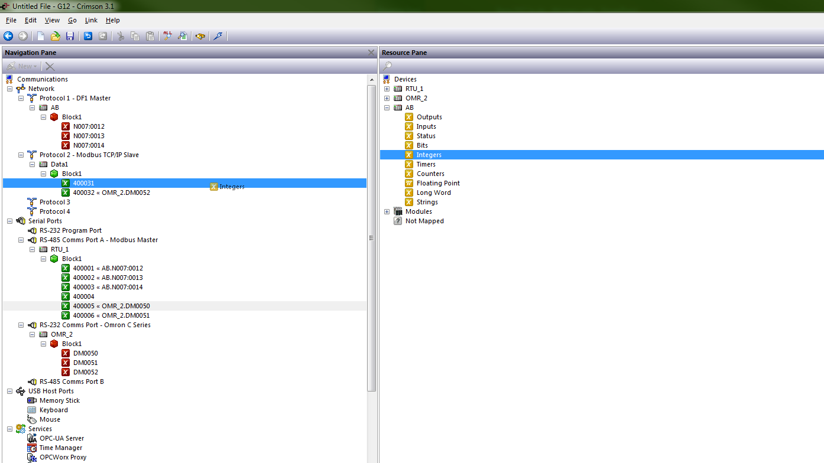
Seamlessly Integrate Multi-Generation, Multi-Vendor Systems
Bridge the communication gap between disparate serial, Ethernet and fieldbus devices, orphaned by incompatible communications standards, using a simple point-and-click user interface

Slide 34
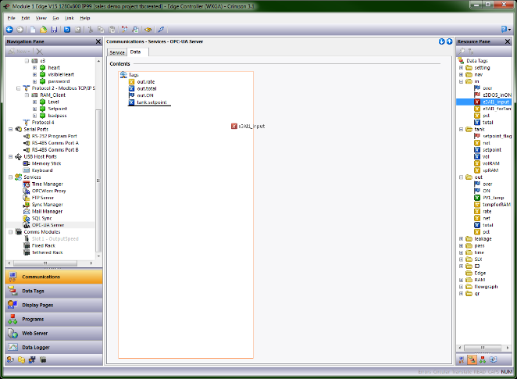
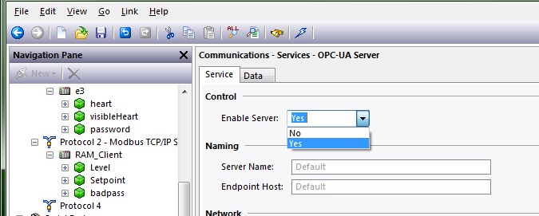
Streamline Data Transfer to Management and Enterprise Systems
Enable Crimson’s 3.1 OPC-UA Server with a simple Yes/No selection
Select any data tag to make it available to OPC-UA clients
  Add deadbands to reduce communications overhead
Eliminate the need for additional intermediate server hardware

Slide 35
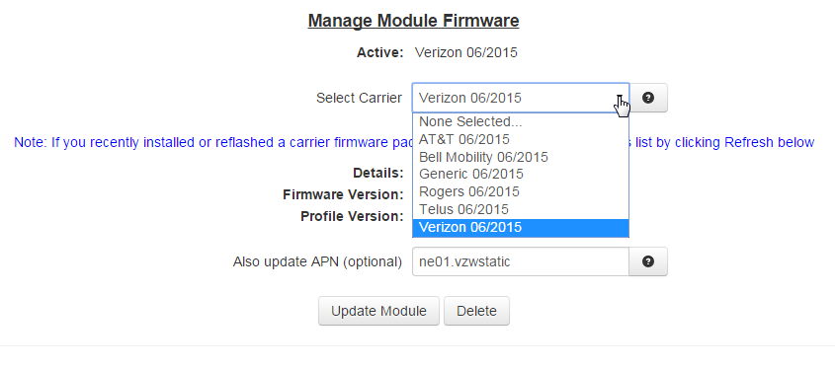
Multi-Carrier Support Delivers
Solution Flexibility
In North America, all five profiles are pre-loaded on each device, so
switching carriers only takes approximately 3 to 5 minutes.

Slide 36
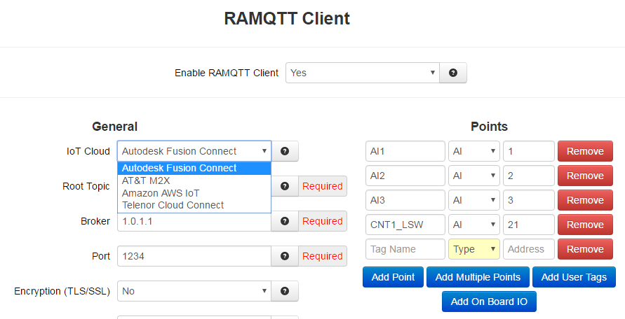
Simplify IIoT Platform Connectivity with RAMQTT
Easy-to-use interface
Select any or all data quickly and intuitively
Select platform providers from a drop-down menu – change as your needs change
Preconfigured profiles mean you can start communicating in ~ 2 minutes

Slide 37
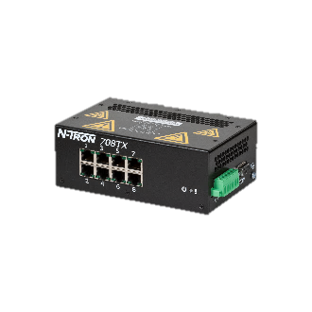




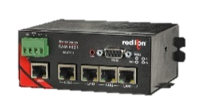
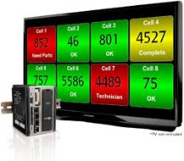
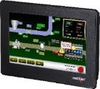
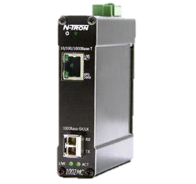


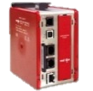
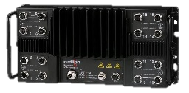
Ensure Operations Visibility, Anywhere
PAX2 Panel Meter
Dual-line, tri color display
Universal power and input capabilities
Optional field installable plug-in cards
Local display of information
ProducTVity Station
Plant floor visualization solution
Simultaneous protocol conversion
Data logging & server synchronization
Integrated web server enables insights anywhere
CR HMI
Local display of information
Simultaneous protocol conversion
Data logging*, SQL server synchronization & queries
Modular Controller
Simultaneous protocol conversion
Data logging & server synchronization

Slide 38
Experience Increased Uptime and Greater
Control of Your Network
708TX
Layer 2 Fast Ethernet
Managed Switch
NT24k-8TX
Layer 2 All Gigabit Managed Switch
NT24k-8TX
Layer 2 All Gigabit Managed Switch
NT24k-16M12
IP67-Rated
Layer 2 All Gigabit
Managed Switch
N-Ring™
Redundant media path
~30ms heal time

Slide 39
Leverage PoE, Media Conversion and
IP67-Rated Products for Additional Uptime
1000-POE+
Gigabit Power Over Ethernet
Injector
1002MC
Industrial Media Converter
NT24k-16M12
IP67-Rated
Layer 2 All Gigabit
Managed Switch

Slide 40
Streamline Your Network and Securely Transmit Data
RAM® 6000
Layer 3 Wired or Cellular Router
Simplify & Secure Your Network
Rugged & Reliable Performance

Slide 41
Summary

Slide 42
Make a plan right now to turn that statistic into
26%
…and rising.

Slide 43
Contents of this document are confidential and for Red Lion Controls use only. © Copyright Red Lion 2019.

