Slide 1
Newest Wave of 98 NT24k™ Switches
WELCOME.
the webcast will begin shortly
Diane Davis | June 2015
NOTE: Due to bandwidth-induced audio problems, the audio portion is via phone only. To connect via phone, select the audio option at the top of your monitor, and follow the dial-in instructions.

Slide 2
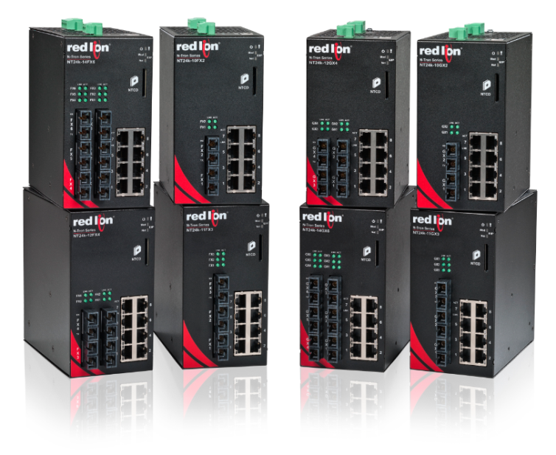
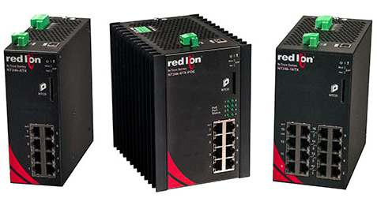
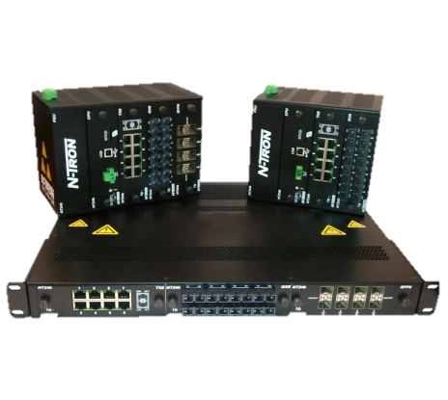
NT24k™ Product Line
Compact Copper Switches
(February 2015)
Compact Fiber & PoE Switches
(June 2015)
Modular Switches
(May 2013)

Slide 3
New Compact NT24k™ Fiber Switches

Slide 4
Compact NT24k™ Fiber Switches
18 new models
NT24k architecture
NT24k robust industrial design
All units have eight 10/100/1000Base copper ports

Slide 5
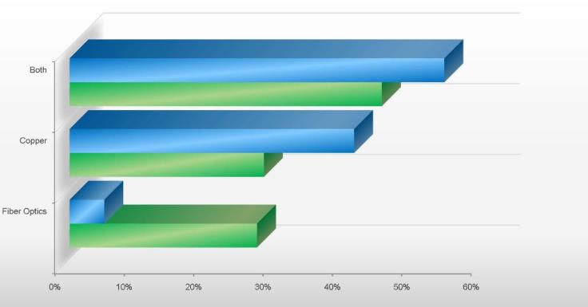
Why so many fiber models?
Market research projects that more users will require mixed copper fiber solutions than copper or fiber alone
Source: VDC

Slide 6
NT24k™ Copper/Fiber Module Sales
Extremely high demand for fiber connectivity

Slide 7
NT24k™ Fiber Configurations
FX models have 100Base fiber
2, 3, 4 or 6 fiber ports with choice of SC or ST connectors
Available with multimode or singlemode (15km, 40km, 80km) fiber
GX models have 1000Base fiber
2, 3, 4 or 6 fiber ports with SC connectors only
Available with multimode or singlemode (10km, 40km, 80km) fiber
DM4 SFP model
4 SFP ports
Supports mix of copper and fiber transceivers and supports both 100Base and 1000Base LC fiber SFP transceivers (dual mode)
PoE models (IEEE 802.3af/at)
FX, GX and DM4 models with PoE+ support on all 8 copper ports

Slide 8
18 New NT24k™ Fiber Models
NT24k-10FX2
NT24k-11FX3
NT24k-12FX4
NT24k-14FX6
NT24k-10GX2
NT24k-11GX3
NT24k-12GX4
NT24k-14GX6
NT24k-12SFP-DM4
NT24k-10FX2-POE
NT24k-11FX3-POE
NT24k-12FX4-POE
NT24k-14FX6-POE
NT24k-10GX2-POE
NT24k-11GX3-POE
NT24k-12GX4-POE
NT24k-14GX6-POE
NT24k-12SFP-DM4-POE

Slide 9
Power over Ethernet (PoE) Technology

Slide 10
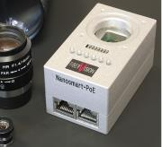
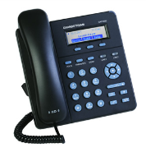
Power over Ethernet (PoE) Benefits
Inexpensive cabling carries both data and power
Eliminates need to run power to Ethernet-enabled devices
Simplifies wiring
Saves labor and material cost
Applications include:
IP cameras
VoIP phones
Wireless access points
Industrial devices (sensors, meters, etc.)

Slide 11
Power over Ethernet (PoE) Comparison
 | PoE (IEEE 802.3af) | PoE+ (IEEE 802.3at)
Max power delivered by PSE | 15.40 W | 34.20 W
Power available at PD | 12.95 W | 25.5 W
Voltage range (at PSE) | 44-57 VDC | 50-57 VDC
Maximum current | 350 mA | 600 mA
Power management | Three levels | Four levels

Slide 12
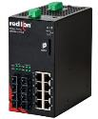
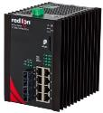
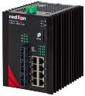
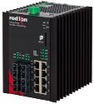
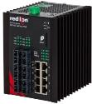
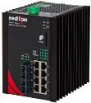
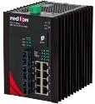
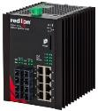
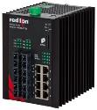
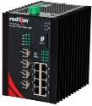
18 New NT24k™ Fiber Models
NT24k-10FX2
NT24k-10FX3
NT24k-10FX4
NT24k-10FX6
NT24k-10GX2
NT24k-10GX3
NT24k-10GX4
NT24k-10GX6
NT24k-10FX2-POE
NT24k-10FX3-POE
NT24k-10FX4-POE
NT24k-10FX6-POE
NT24k-10GX2-POE
NT24k-10GX3-POE
NT24k-10GX4-POE
NT24k-10GX6-POE
NT24k-12SFP-DM4
NT24k-12SFP-DM4-POE

Slide 13
Compact NT24k™ Switch Features
Compact industrial design
IEEE 802.3 compliant
Managed operation
Extended environmental specifications
Supports full/half duplex operation
Auto sensing 10/100/1000Base-T(X), duplex and MDIX
ESD and surge protection on all built-in ports
Store-and-forward technology

Slide 14
Compact NT24k™ Switch Features
Full wire-speed communication
LED status indicators
USB configuration port
Configurable alarm contact
Hardened metal enclosure
Fast 38 second boot time
High tolerance to shock (200 g) and vibration (50 g)
MTBF > 2 million hours

Slide 15
Compact NT24k™ Switch Features
SD and XML configuration backup and recovery options
Jumbo frame support
Supports up to 16k MAC addresses
Fully managed features:
Multi-member N-Ring™ technology with ~30ms healing
Detailed ring map and fault location charting
N-Link™ redundant ring technology
N-View™ monitoring technology
EtherNet/IP™ CIP™ messaging
SNMP v1, v2, v3
Web configuration and management
EtherNet/IP and CIP are trademarks of ODVA.

Slide 16
Compact NT24k™ Switch Features
IGMP auto configuration
802.1Q tag VLAN and port VLAN
802.1p QoS and port QoS
802.1d, 802.1w, 802.1D RSTP
Port trunking/port mirroring
DHCP client
Local port IP addressing
Event logging
IEEE 802.1x with RADIUS remote server authentication
SNTP (Simple Network Time Protocol)

Slide 17
Compact NT24k™ Switches (non-PoE)
Redundant power inputs 10-49 VDC
-40°C to 85°C operating temperature
Optional accessories
NTPS-24-1.3 DIN-rail power supply, 1.3 Amp @ 24V
NTCD-CFG NT24k configuration recovery device
NT24k-NM-PMK Panel mount kit
URMK Universal rack mount kit

Slide 18
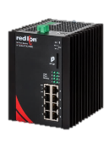
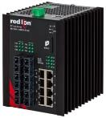
Compact NT24k™ Switches (with PoE)
8 Gigabit copper ports, all support PoE+
PoE+ (240 watt power budget) IEEE 802.3af/at
Redundant power inputs 22-49 VDC
Boosts power to meet PoE output requirements
-40°C to 80°C operating temperature
Accessories/Options
NTPS-24-20 DIN-rail power supply, 20 Amp @ 24V
NTPS-48-10 DIN-rail power supply, 10 Amp @ 48V
NTCD-CFG NT24k configuration recovery device
NT24k-NM-PMK Panel mount kit
URMK Universal rack mount kit

Slide 19
NT24k™ Regulatory & Certifications
FCC
CE
UL Class I, Division 2 Listing
ABS for maritime applications
RoHS compliant
EN50155/EN50161 rail certification (planned)

Slide 20
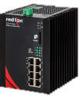
Compact NT24k™ Switch Portfolio
NT24k-10FX2
NT24k-10FX3
NT24k-10FX4
NT24k-10FX6
NT24k-10GX2
NT24k-10GX3
NT24k-10GX4
NT24k-10GX6
NT24k-10FX2-POE
NT24k-10FX3-POE
NT24k-10FX4-POE
NT24k-10FX6-POE
NT24k-10GX2-POE
NT24k-10GX3-POE
NT24k-10GX4-POE
NT24k-10GX6-POE
NT24k-12SFP-DM4
NT24k-12SFP-DM4-POE
NT24k-8TX
NT24k-16TX
NT24k-8TX-POE

Slide 21
101 Configurations of Fiber and PoE Switches
NT24k-8TX
NT24k-16TX
NT24k-8TX-POE
NT24k-10FX2-SC
NT24k-10FX2-ST
NT24k-10FXE2-SC-15
NT24k-10FXE2-SC-40
NT24k-10FXE2-SC-80
NT24k-10FXE2-ST-15
NT24k-10FXE2-ST-40
NT24k-10FXE2-ST-80
NT24k-10GX2-SC
NT24k-10GXE2-SC-10
NT24k-10GXE2-SC-40
NT24k-10GXE2-SC-80
NT24k-11FX3-SC
NT24k-11FX3-ST
NT24k-11FXE3-SC-15
NT24k-11FXE3-SC-40
NT24k-11FXE3-SC-80
NT24k-11FXE3-ST-15
NT24k-11FXE3-ST-40
NT24k-11FXE3-ST-80
NT24k-11GX3-SC
NT24k-11GXE3-SC-10
NT24k-11GXE3-SC-40
NT24k-11GXE3-SC-80
NT24k-12FX4-SC
NT24k-12FX4-ST
NT24k-12FXE4-SC-15
NT24k-12FXE4-SC-40
NT24k-12FXE4-SC-80
NT24k-12FXE4-ST-15
NT24k-12FXE4-ST-40
NT24k-12FXE4-ST-80
NT24k-12GX4-SC
NT24k-12GXE4-SC-10
NT24k-12GXE4-SC-40
NT24k-12GXE4-SC-80
NT24k-14FX6-SC
NT24k-14FX6-ST
NT24k-14FXE6-SC-15
NT24k-14FXE6-SC-40
NT24k-14FXE6-SC-80
NT24k-14FXE6-ST-15
NT24k-14FXE6-ST-40
NT24k-14FXE6-ST-80
NT24k-14GX6-SC
NT24k-14GXE6-SC-10
NT24k-14GXE6-SC-40
NT24k-14GXE6-SC-80
NT24k-10FX2-SC-POE
NT24k-10FX2-ST-POE
NT24k-10FXE2-SC-15-POE
NT24k-10FXE2-SC-40-POE
NT24k-10FXE2-SC-80-POE
NT24k-10FXE2-ST-15-POE
NT24k-10FXE2-ST-40-POE
NT24k-10FXE2-ST-80-POE
NT24k-10GX2-SC-POE
NT24k-10GXE2-SC-10-POE
NT24k-10GXE2-SC-40-POE
NT24k-10GXE2-SC-80-POE
NT24k-11FX3-SC-POE
NT24k-11FX3-ST-POE
NT24k-11FXE3-SC-15-POE
NT24k-11FXE3-SC-40-POE
NT24k-11FXE3-SC-80-POE
NT24k-11FXE3-ST-15-POE
NT24k-11FXE3-ST-40-POE
NT24k-11FXE3-ST-80-POE
NT24k-11GX3-SC-POE
NT24k-11GXE3-SC-10-POE
NT24k-11GXE3-SC-40-POE
NT24k-11GXE3-SC-80-POE
NT24k-12FX4-SC-POE
NT24k-12FX4-ST-POE
NT24k-12FXE4-SC-15-POE
NT24k-12FXE4-SC-40-POE
NT24k-12FXE4-SC-80-POE
NT24k-12FXE4-ST-15-POE
NT24k-12FXE4-ST-40-POE
NT24k-12FXE4-ST-80-POE
NT24k-12GX4-SC-POE
NT24k-12GXE4-SC-10-POE
NT24k-12GXE4-SC-40-POE
NT24k-12GXE4-SC-80-POE
NT24k-14FX6-SC-POE
NT24k-14FX6-ST-POE
NT24k-14FXE6-SC-15-POE
NT24k-14FXE6-SC-40-POE
NT24k-14FXE6-SC-80-POE
NT24k-14FXE6-ST-15-POE
NT24k-14FXE6-ST-40-POE
NT24k-14FXE6-ST-80-POE
NT24k-14GX6-SC-POE
NT24k-14GXE6-SC-10-POE
NT24k-14GXE6-SC-40-POE
NT24k-14GXE6-SC-80-POE
NT24k-12SFP-DM4
NT24k-12SFP-DM4-POE

Slide 22
Compact NT24k™ Switch Benefits
Full range of connectivity options in a small footprint
10/100/1000Base copper with a broad range of 100Base and Gigabit fiber options
IEEE 802.3af/at (POE+)
Eliminates need for separate power and data cables
Step-up power boost circuit eliminates additional power supplies
Rugged, reliable hardware design
Wide operating temperature range
Simplified network deployment
Robust plug-and-play managed feature set

Slide 23
NT24k™ Platform
Rugged design
Fiber & PoE+ options
Managed Gigabit platform

