Slide 1
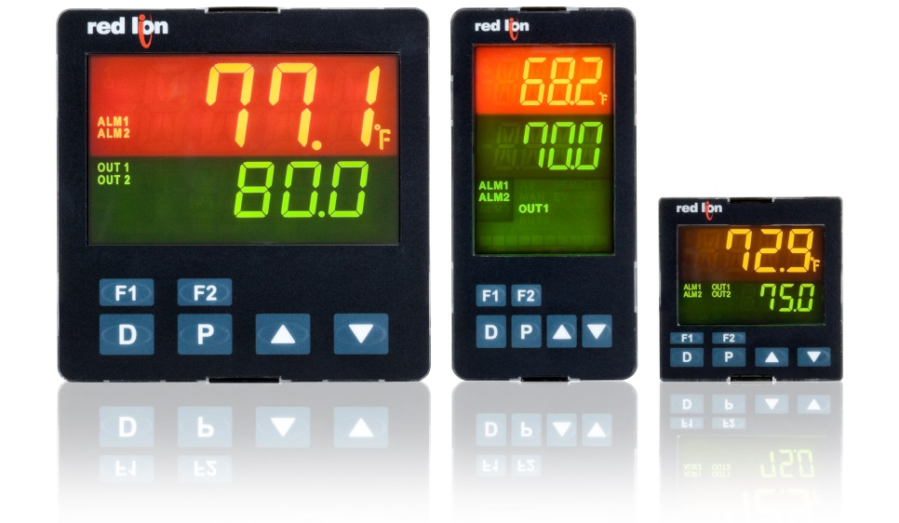
Introducing PXU PID Controller Series

Slide 2
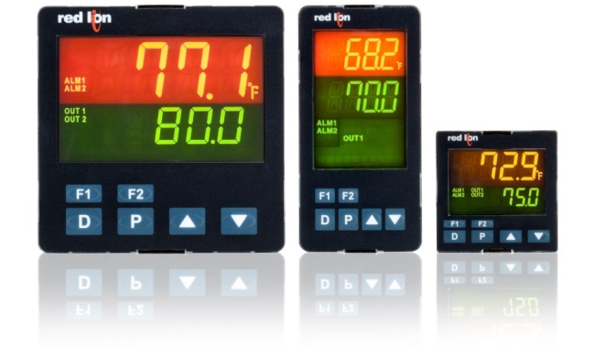
PXU Features
1/16, 1/8 and 1/4 DIN models
Full PID control
Universal inputs
  Thermocouple, RTD
  0 - 10 VDC, 4 - 20 mA (0 - 50)
On demand auto-tuning for easy set up
Programmable via front panel push buttons and/or Crimson 2
Optional RS-485 communications allows integration with PCs, PLCs and HMIs
One inch shorter in depth to save panel space
Initial offering AC powered (100 to 240 VAC)
UL listed, 61010-1, process control equipment

Slide 3
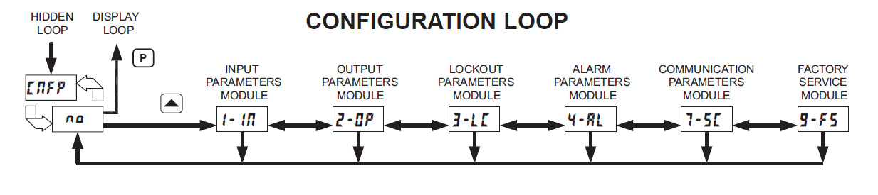
Programs like a T16
Easy Menu-Driven Programming

Slide 4
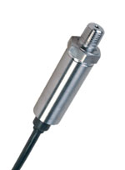
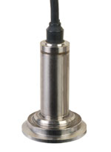
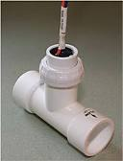
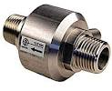
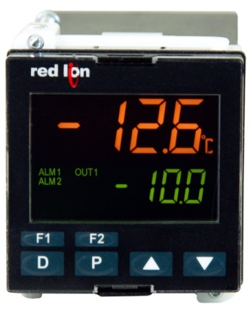
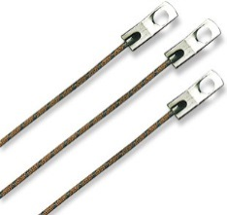
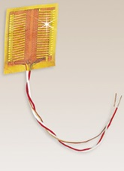
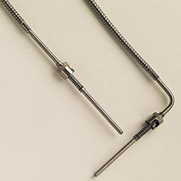
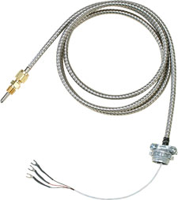
Universal Inputs
DC Voltages
Pressure Transducers
Flow Meters
Thermocouples
DC Currents
RTDs

Slide 5
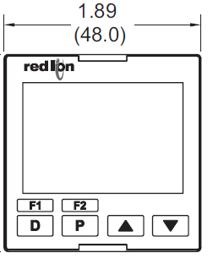
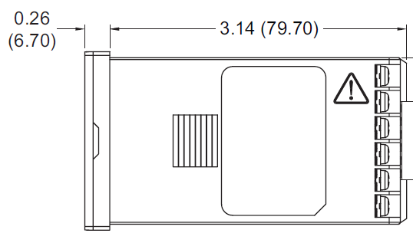

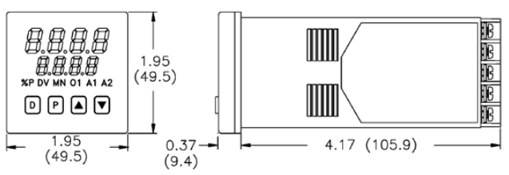
Mechanical Advantages
One inch shorter
Front panel rated IP65
Two user-programmable buttons
PXU
T48

Slide 6
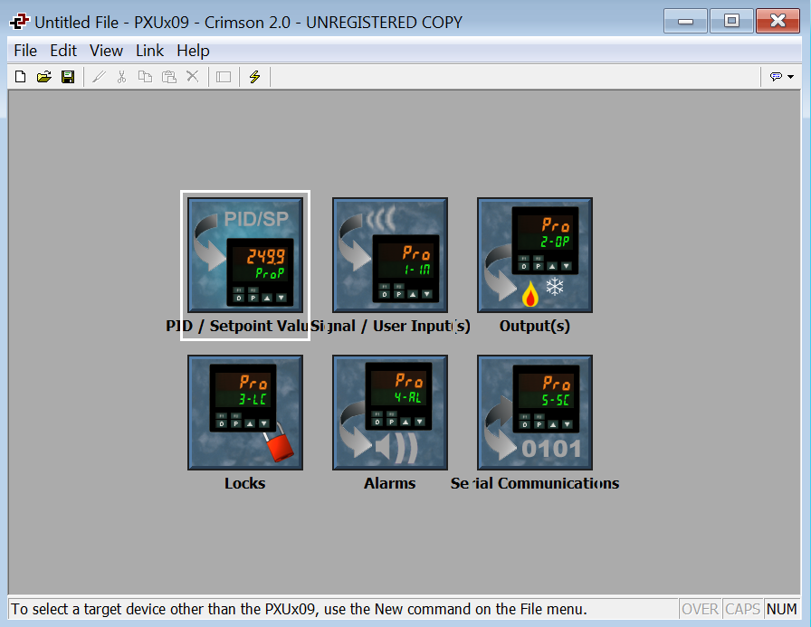
Easy Crimson 2 Programming
Requires RS-485 communications option

Slide 7
Competitive Comparison

Slide 8
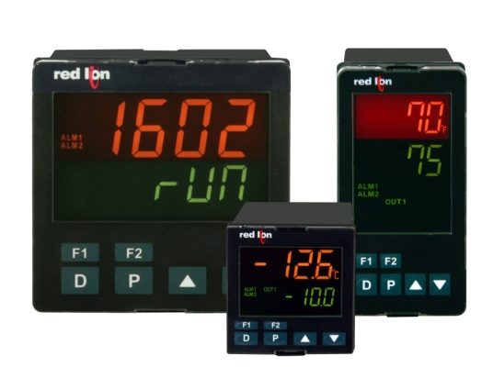
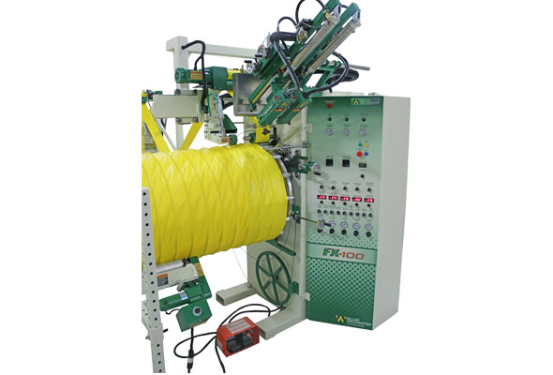

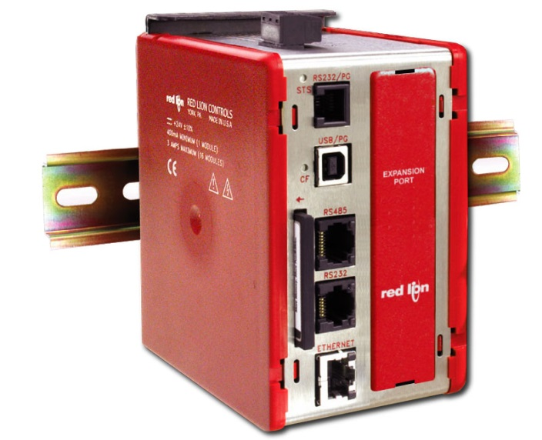
Advanced Monitoring
Add RS485 Communications
Data Station Plus

Slide 9

Advanced Monitoring
Data Station Plus
Remote view of equipment
  Using an iPad, smart phone or computer,
  all connected equipment can be monitored
SMS/text messages
  Provides a warning for a fault condition
  Decreases waste
Data logging
  Provide date/time stamp of temperature readings
Budget friendly products
  Add the advanced monitoring now or in the future
The value for Factory Automation or Commercial Equipment
is the same, immediately knowing about issues will save time, materials and money!

Slide 10

Use Our Free Replacement Program

Slide 11
Try ours today
The NEW
PXU PID Controller Series

Slide 12
Questions?

