Slide 1
Workshop 2013
Networking | April 2013

Slide 2
Workshop Agenda
Networking review
Unmanaged, monitored, managed
The move to managed.
Copper vs. Fiber
Multimode vs. Singlemode Fiber
Topologies
Layer 3
Red Lion networking portfolio
Deciding which product line to pitch for specific opportunities
NT24k Introduction
NT24K/N-Ring Demo

Slide 3
Networking Review

Slide 4
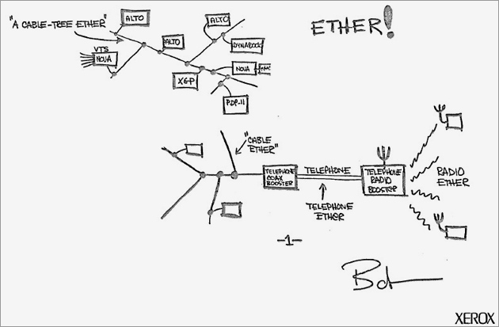
History of Ethernet
May 1973—Bob Metcalfe, of Xerox, defines Ethernet network system
The computer can send data at anytime
If the message collides with a transmission from another computer, try later
Only 18% efficient; 82% of the bandwidth was lost due to collisions
Ethernet can have high efficiency
How? (switches and duplex)
Drawing from patent submission.
U.S. Patent Office
Notes:
Networking allows one computer or device to send information to and from another computer or device.
The Internet is the most conspicuous example of computer networking, linking millions of computers around the world, but smaller networks play a large role in information access on a daily basis.
Bob Metcalfe designed and tested the first Ethernet network while working on a way to link Xerox’s computer to a printer.
The original Ethernet described communication over a single cable shared by all devices on the network. Once a device attached to this cable, it had the ability to communicate with any other attached device. This allows the network to expand to accommodate new devices without requiring any modification to those devices already on the network.
He chose to base the name on the word "ether" as a way of describing an essential feature of the system: the physical medium (i.e., a cable) carries bits to all stations, in the same way that the old "luminiferous ether" was once thought to propagate electromagnetic waves through space. Thus, Ethernet was born.”
Ethernet has become the most popular and most widely deployed network technology in the world.

Slide 5
Ethernet Cabling

Slide 6
Ethernet Medium
Ethernet devices (computers, PLCs, drives, etc) attach to a common medium that provides a path along which the electronic signals will travel.
Historically, this medium has been coaxial copper cable, but today it is more commonly twisted pair or fiber optic cabling.
Notes:
Historically, this medium has been coaxial copper cable, but today it is more commonly a twisted pair or fiber optic cabling.
The original Ethernet described communication over a single cable shared by all devices on the network.

Slide 7
Ethernet 802.3 Standards
Name | IEEE Standard | Data Rate | Media Type | Maximum Distance
Ethernet | 802.3 | 10 Mbps | 10Base-T | 100 meters
Fast Ethernet/ 100Base-T | 802.3u | 100 Mbps | 100Base-TX 100Base-FX (mm) 100Base-FX (sm) | 100 meters 2km ~70km
Gigabit Ethernet/ GigE | 802.3z | 1000 Mbps | 1000Base-T 1000Base-SX 1000Base-LX | 100 meters 550 meters 10km – ~70km
10 | network operates at 10Mbps
100 | network operates at 100Mbps
1000 | network operates at 1000Mbps (1Gbps)
BASE | baseband signaling
T | twisted-pair cable
X | full duplex-capable cable
FX | fiber optic cable
SX | multimode fiber optic
LX | singlemode fiber optic
Example: 100BASE-TX indicates a Fast Ethernet connection (100 Mbps) that uses a twisted pair cable capable of full-duplex transmissions.
Notes:
100 meters = 328 feet
1000base-LX singlemode
10km GBIC - $300
70km GBIC - $2,000

Slide 8
Ethernet Cabling
Cable Name | Makeup | Data Rate | Network Compatibility
Cat1 | 2 pairs of copper wire -- terminated by RJ-11 connectors | 1Mbps | Phone lines & doorbells
Cat3 | 4 twisted pairs of copper wire -- terminated by RJ-45 connectors | 10Mbps – 2 pair | 10Base-T
Cat5 | 4 twisted pairs of copper wire -- terminated by RJ-45 connectors | 100Mbps – 2 pair 1,000Mbps – 4 pair | 10Base-T 100Base-TX
Cat5e | 4 twisted pairs of copper wire -- terminated by RJ-45 connectors | 1,000Mbps – 2 pair | 100BaseTX 1000Base-TX
Cat6a | 4 twisted pairs of copper wire -- terminated by RJ-45 connectors | 10,000Mbps – 2 pair | 100Base-TX, 1,000Base-TX 10,000Base-TX
Notes:
Categories 1 through 6 are based on the TIA-568 standards. Most new wiring for LANs is CAT5e, which is an improved version of CAT5 that adds specifications for far end crosstalk
Cat5e cable does not enable longer cable distances for Ethernet networks: cables are still limited to a maximum of 100 m (328 ft) in length (normal practice is to limit fixed ("horizontal") cables to 90 m to allow for up to 5 m of patch cable at each end).
Most Industrial control Components currently in production are running 10/100BaseT. Industrial networks should be constructed using Cat5e shielded twisted pair (STP) cable with a shielded RJ-45 connector on one end of the cable only.

Slide 9
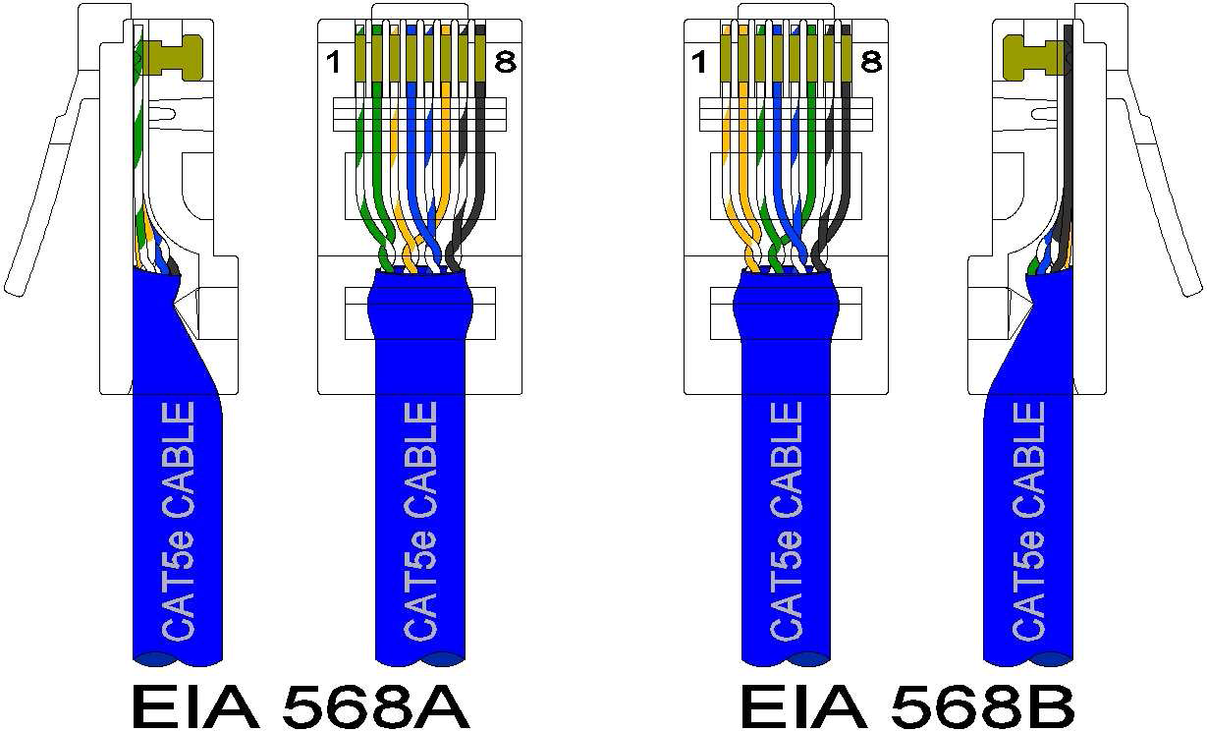
Ethernet Cabling Standards

Slide 10
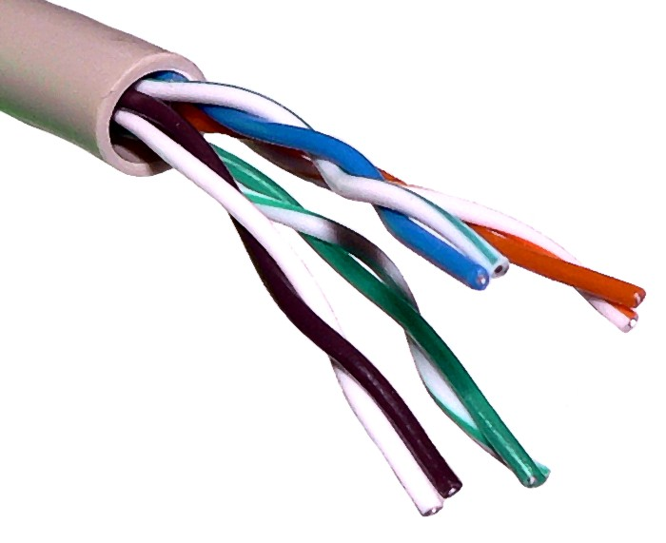
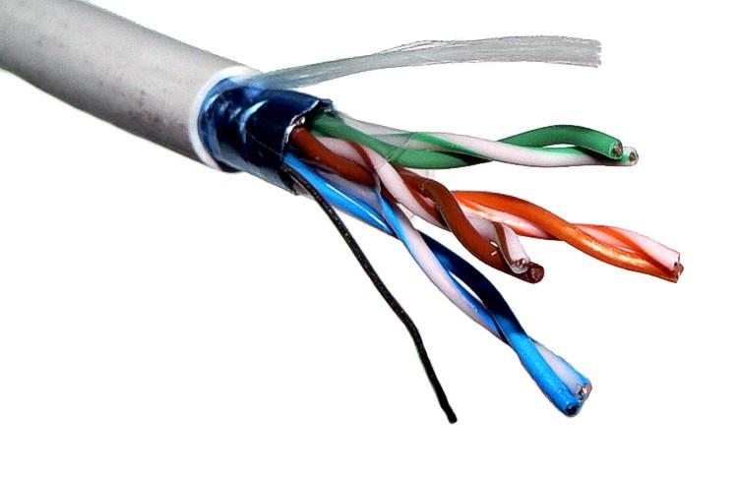
Twister pair cable
Twisted pair cabling is a form of wiring in which two conductors are wound together for the purposes of canceling out electromagnetic interference (EMI) from crosstalk between neighboring pairs and other external sources.
UTP: Unshielded Twisted Pair
STP: Shielded Twisted Pair
Do not use the extra pairs for voice or an extra data line.
The electrical noise in the wires can interfere with your network.
Notes:
• EMI is potentially harmful to your communications system because it can lead to signal loss and degrade the overall performance of high-speed, CAT-5e cabling
• EMI causes interference in the signal and is caused by the radiation of electrical or magnetic fields which are present near power cables, heavy machinery, or fluorescent lighting
• Avoiding EMI is as simple as not laying your network cable within 12" of electrical cable, or, if needed, switching to more expensive shielded cable
• Overall shield with drainwire
• Recommended for areas with high electromagnetic or radio frequency interference (EMI/RFI)
• The shield acts as a ground
• The shielding MUST be grounded to be effective

Slide 11
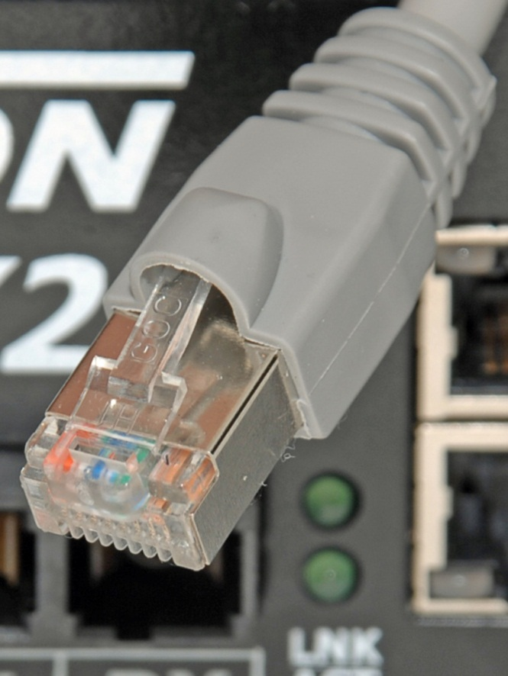
UTP / STP
Ungrounded RJ-45
Grounded RJ-45
Notes:
Historically, this medium has been coaxial copper cable, but today it is more commonly twisted pair or fiber optic cabling.

Slide 12
Auto MDIX
Twisted Pair ports on end stations must be connected so that the transmit pair on one end is connected to the receive pair on the other end.
Hubs/switches are deliberately wired opposite from end stations. A straight through Ethernet cable can be used between a hub/switch and an end station to match pairs properly.
When two hub/switches/routers are connected to each other, or two end stations are connected to each other, a crossover cable is used to make sure that the correct pairs are connected.
Notes:
NIC = Network Interface card

Slide 13
Fiber Optic Cabling
Notes:
Fiber Optic communications involves sending signals down hair-thin strands of glass or plastic fiber. The light is "guided" down the center of the fiber called the "core". The core is surrounded by a optical material called the "cladding" that traps the light in the core using an optical technique called "total internal reflection." The core and cladding are usually made of ultra-pure glass, although some fibers are all plastic or a glass core and plastic cladding.
Singlemode fiber shrinks the core down so small that the light can only travel in one ray. This increases the bandwidth to almost infinity - but it's practically limited to about 100,000 gigahertz - that's still a lot! Singlemode fiber also allows for extended runs of cable, known as “Long-Haul”. Singlemode fiber cable runs can extend to 80km or more, where as Multimode fiber has a 2km limit.

Slide 14
Fiber Communication

Slide 15
100BaseFX Fiber Optic Cable
Multimode Fiber Optic Cable
50 or 62.5/125 Micron Cable ID/OD
LED Transceivers to 2km
Singlemode Fiber Optic Cable
7 or 10/125 Micron Cable ID/OD
Laser Transceivers to 15, 40, or 80 km
Fiber Optic Connectors
ST – Twist Lock
SC – Clip Lock
LC – Clip Lock
Notes:
Fiber-optic cable is more expensive but it is invaluable in situations where electronic emissions and environmental hazards are a concern. Because it does not conduct electricity, fiber-optic cable can be useful in areas where heavy electromagnetic interference is present, such as the factory floor. The Ethernet standard allows for fiber-optic cable segments from 2 kilometers to 80 kilometers long. Fiber-optic cable is often used in intra-building applications to insulate networking equipment from electrical damage caused by lightning.

Slide 16
1000Base LX/SX Fiber Optic Cable
Multimode Fiber Optic Cable
50 or 62.5/125 Micron Cable ID/OD
LED Transceivers
50 Micron 500 meters
62.5 Micron 330 meters
Singlemode Fiber Optic Cable
7 or 10/125 Micron Cable ID/OD
Laser Transceivers to 10, 40 or 80 km
Fiber Optic Connectors
SC – Clip Lock
LC – Clip Lock
Notes:
1000base-LX singlemode
10km GBIC - $300
80km GBIC - $2,000

Slide 17
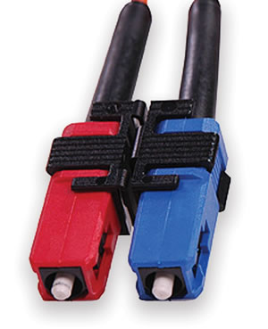
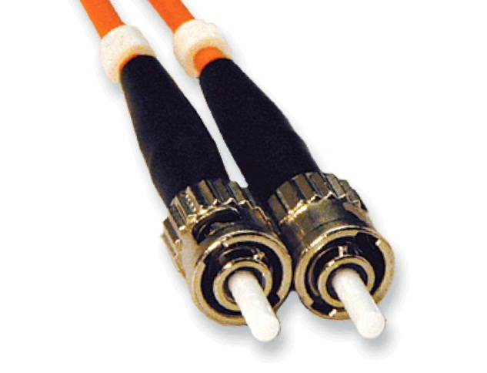
SC / ST Fiber Optic Connectors
SC Fiber Optic Connector
ST Fiber Optic Connector
Notes:
Examples of fiber optic connectors.

Slide 18
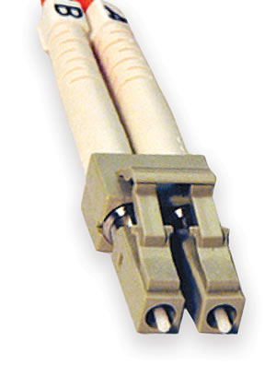
LC Fiber Optic Connector
LC Fiber Optic Connector
Notes:
The LC connector resembles a small SC connector.
Lucent Technologies developed the LC connector for use in TelCo environments.

Slide 19
Benefits of Using Fiber
Extended distance
Noise Immunity
Surge Immunity

Slide 20
What do I need to know about fiber install?
Type of Fiber being used – MM or SM
Data Rate and standard – 10BaseFL to 1000BaseLX
Wavelength – 850nm, 1310nm, 1550nm, (CWDM, DWDM)

Slide 21
Commercial vs. Industrial
Specifications | Typical Commercial Switch with Fan Cooling | Typical Industrial Switch and Field Devices | Red Lion Switches
MTBF Hours | 25K | 200K | >1M
Vibration/Shock | 1/5G | 5/10G | 50/200G
ESD/Overvoltage Protection | 2KV | 4KV to 6KV | 16KV
Operation Temp | 0° to 45° | -20° to 60° | -40° to 85°
Notes:
Red Lion blows away the competition with true industrial specs.
Designed to handle nuclear applications.
Best in class for all types of industrial environments.

Slide 22
Hubs vs. Switches

Slide 23
Ethernet Hubs
A hub is also known as a repeater
A hub is a multi-port device that connects multiple Ethernet devices together to create a network segment or collision domain
Extend distances past 100 meters
Disadvantages
Hubs forward data packets to all ports, except the port of entry (broadcast)
Transmission mode is half duplex – collisions are likely!
All devices receive every transmission
No MAC address learning
Bad choice for control systems

Slide 24
Ethernet Switch
Ethernet switches operate at the layer two (data link) layer of the OSI model
They “learn” MAC addresses.
Layer 2 switches break up collision domains. Network devices can send and receive as needed.
Sends data only to the device(s) intended, by using MAC addresses
Excellent choice for control systems

Slide 25
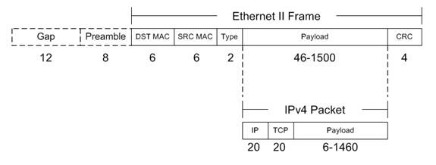
Ethernet Frame

Slide 26
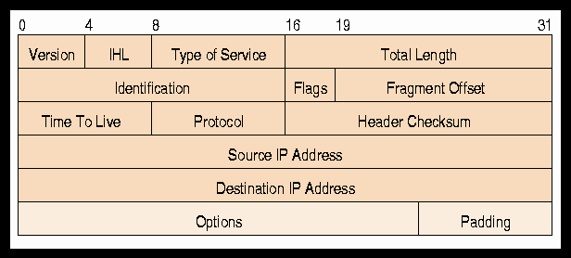
IP Packet
Below is contained in the “Data” portion of the Ethernet Frame

Slide 27
Unmanaged Switches
Basic IEEE 802.3 MAC based switching functions
No configurable parameters
Cannot be configured to optimize LAN traffic
Unmanaged switches offer plug and play operation
Can’t be used in a redundant config (Ring, Mesh)

Slide 28
Monitored Unmanaged Switches
The N-Tron series has a unique line of unmanaged switches with monitoring capability through N-View
Unmanaged switches with the N-View option provide the same plug and play benefits of traditional unmanaged switches but also provide the ability to monitor port configuration and traffic data
N-View data packets are autocast from the switch containing diagnostic information
The information is captured by the N-View OPC server software which works with industry standard OPC client software, including most popular HMI packages

Slide 29
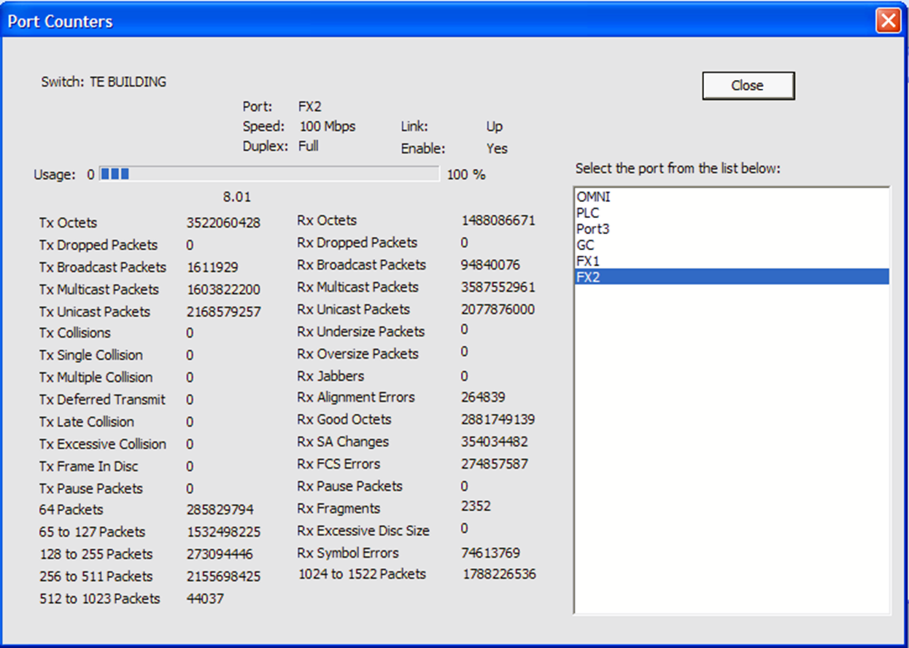
N-View Troubleshooting
Notes:
The Port Counters Window presents all of the data points collected on the ports. Highlighting the port in the port list will display the data for that port.
At 10Mbs/half duplex, anything over 17% usage is unusable.
Usage – Percentage of speed the port is running.
Octet is the same as byte.
Fiber Optics – validation tool for your fiber. Intermittent issues, RX FCS, RX Fragment, RX Symbol errors will increment with fiber issues.
A very expensive fluke meter ($20K) will NOT tell you this information.
Note you get the IP address connected to the ports. Note on camera 3 we are now set-up for Full Duplex (from past slide error). SNMP only gives you data over time. Point out that this application is using fiber. With N-View, the user has the capability to look at DB and see if there is loss by observing RX Alignment counters which will increment on a bad fiber connection. No other company offers this feature. You could spend $1000 on a fluke meter to get only a portion of this information!!

Slide 30
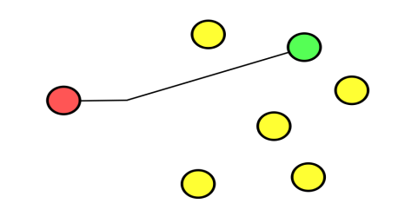
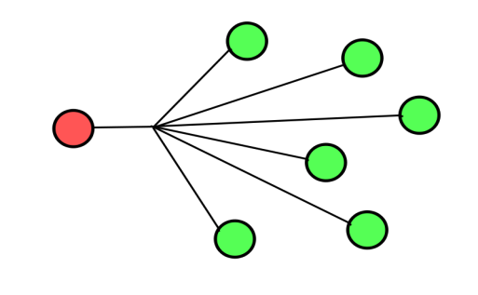
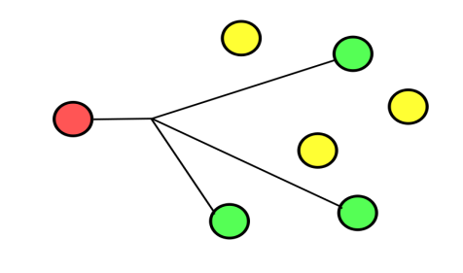
Layer 2 Frame Types
Unicast | One to One
Broadcast | One to All
Multicast | One to Many

Slide 31
Managed Switches
Managed switches provide all of the features of an unmanaged switch and provide the ability to configure and monitor your network
Managed switches support protocols such as SNMP (Simple Network Management Protocol) that provides information about the switch to facilitate remote management
Additional advanced management features include:
QoS (Quality of Service)
VLANs (Virtual LAN) which allows network segmentation
STP/RSTP (Spanning Tree and Rapid Spanning Tree Protocol) which for redundancy
Port Mirroring
IGMP - Multicast control

Slide 32
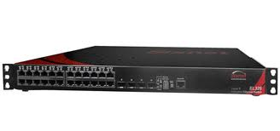
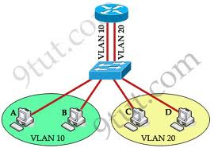
Layer 3
Layer 3 adds routing capability
Allows packets to cross network domains
VLAN to VLAN connections
Can be accomplished in a single unit
Layer 3 switch

Slide 33
Network Topologies

Slide 34
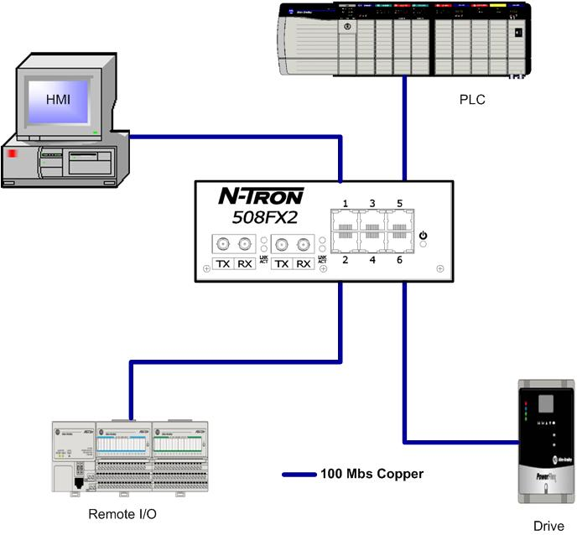
Star Topology
Notes:
HIGHEST BANDWIDTH
LOWEST COST SWITCHES
LOWEST LATENCY
GREATEST DETERMINISM
HIGHER CABLING COSTS
NO MEDIA REDUNDANCY
NO EQUIPMENT REDUNDANCY

Slide 35
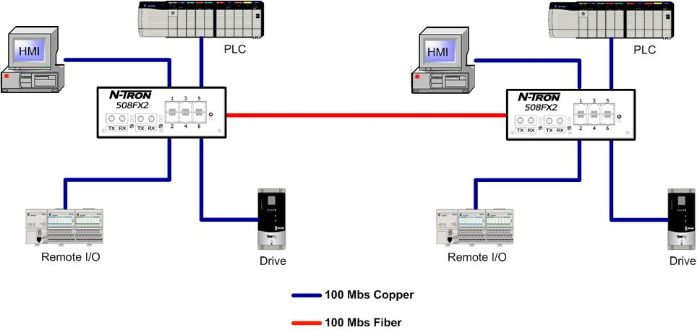
Tree Topology
Notes:
MEDIUM BANDWIDTH
LOW COST SWITCHES
MEDIUM LATENCY
MEDIUM DETERMINISM
NO MEDIA REDUNDANCY
LOWER CABLING COSTS

Slide 36
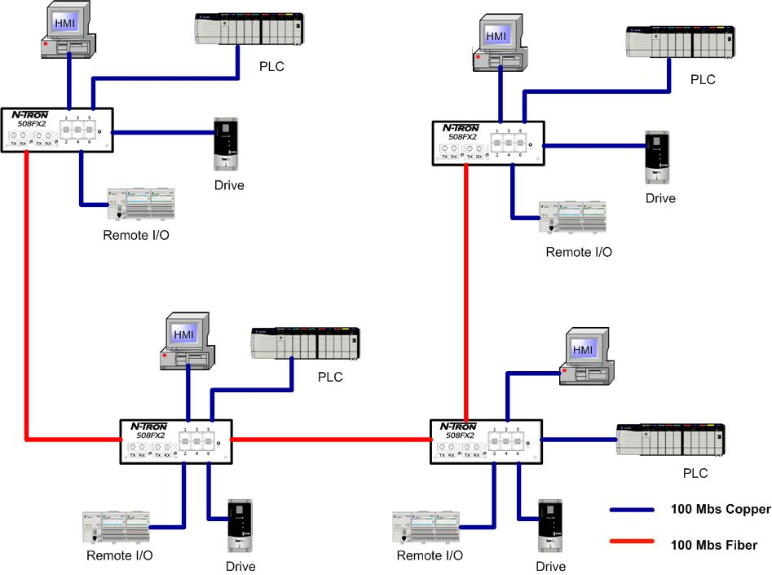
Daisy Chain Topology
Notes:
LOWEST BANDWIDTH
LOW COST SWITCHES
HIGH LATENCY
LOW DETERMINISM
NO MEDIA REDUNDANCY
NO EQUIPMENT REDUNDANCY
LOWEST CABLING COSTS

Slide 37
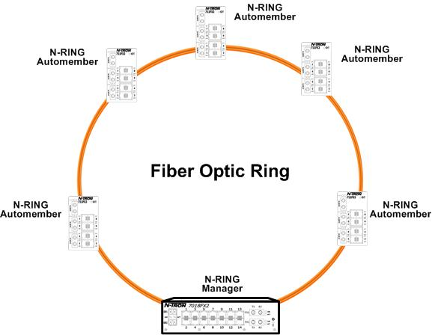
Ring Theory of Operation










Notes:
Animation
No clicks are required in this slide. The animations will play through the blinking arrows, then click to go to the next slide: ring break.
A Ring Manager is required. There are two choices:
Proprietary health check packet & time outs. Heal times range from < 300ms to < 5ms (allegedly).
STP or RSTP BPDU health check packets. IEEE 802.1W with Fast Edge heals ~1-2 seconds.
A Periodic Health Check Packet is transmitted by the RM on designated ports.
When loop is detected by the RM, it blocks the ring by disabling one of the loop port. This prevents broadcast and multicast storms.

Slide 38
Ring Protocols
There are two ring types
IEEE Standard Protocols (STP, RSTP)
Proprietary Ring Protocols (Vendor specific)
Packets are transmitted around the ring to discover loops
When a loop is detected, the protocol must break the ring by disabling one of the loop ports. This prevents broadcast and multicast storms.
When another active connection fails, the protocol must enable a port to “heal” the network.

Slide 39
STP/RSTP Protocols
Spanning Tree (STP) IEEE 802.1
30-120 second update rate
Rapid Spanning Tree (RSTP) IEEE 892.1W
2-3 second update rate
RSTP with Fast Edge IEEE 802.1D
1-2 second update rate

Slide 40
Red Lion Proprietary Ring Protocols
RTR – Real Time Ring
30ms + 5ms per hop
Multiple rings per switch supported
Mixed media per ring
N-Ring
30ms heal time
Up to 250 fully managed N-Tron switches per ring

Slide 41
Break












Notes:
Animation
Timings: Slide plays from beginning to break.
Click – block disappears and arrows appear showing that the ring has changed to a linear topology. Click to proceed to next slide: ring healing
Installing the toughest network infrastructure products and safeguarding cable in conduit or protected runs help to insure reliability. There is always the unforeseen accident lurking in the wings, remember Murphy’s law. In order to Build a reliable industrial network one must consider many possibilities. Ever had a forklift accident.

Slide 42
Ring Healing




Converted to a backbone after break




Upon repair N-RING is re-established




Notes:
Animation
When loop is broken, the ring manager flushes its ARL and reverts to a normal non-blocking switch. Ring topology reverts to fiber backbone.

Slide 43
Recent Introductions

Slide 44
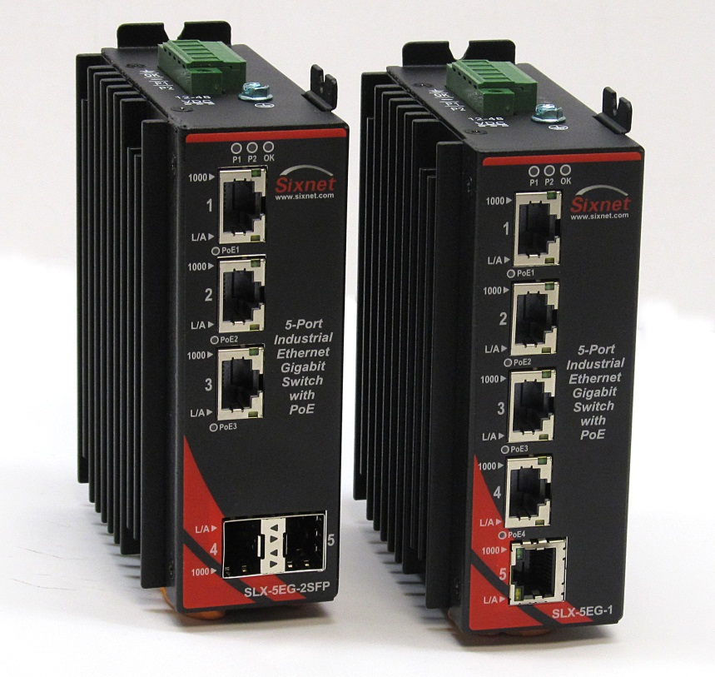
SLX5EG
5 Gigabit ports
802.3af PoE Capable
Auto-sensing speed and duplex
Dual Power inputs
10-48 VDC
-40 to 85°C Operating Temp
Class I, Div 2 (HazLoc)

Slide 45
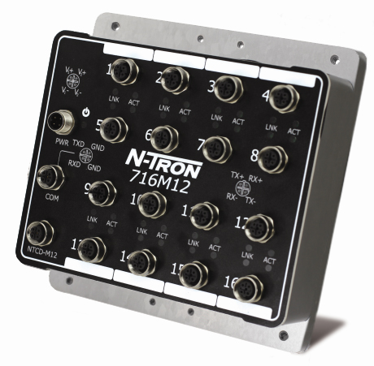
716M12
Wash down; dustproof; temporary water immersion
Web browser, SNMP v1, v2 v3
EtherNet/IP CIP messaging
RSTP Ring & N-Ring management
DHCP Server Option 61 & 82, IP Fallback
LLDP & MAC/IP port discovery
MAC Port security
N-View
200 G shock; 50 G vibration
Class I, Div 2 (HazLoc)
EN50155
716M12
10-49 VDC input
-40 to 85°C
716M12-HV
40-160 VDC input
-40 to 80°C
Manufactured in the USA

Slide 46
N-Tron and Sixnet Product Series

Slide 47
Two Product Lines
Both lines offer rugged industrial designs
N-Tron
Optimized for factory automation
Designed for fast installation, quick boot up time
Sixnet
Optimized for process control and military applications
Advanced models with enterprise-like features

Slide 48
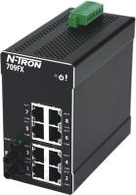
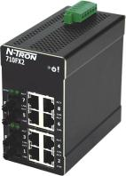
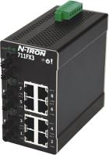
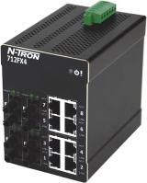
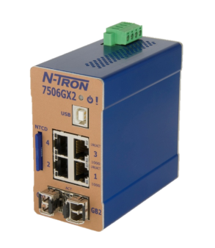
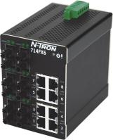
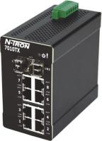
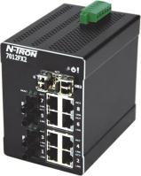
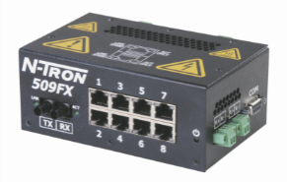
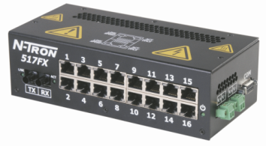
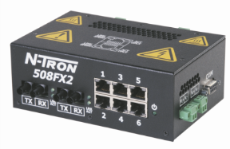
N-Tron Product Line
Excellent environmental and reliability specs
Unequaled noise immunity
Extreme shock and vibration tolerance
Automatic EtherNet/IP™ configuration
Exclusive N-View™ OPC monitoring
Notes:
Best in class Industrial Ethernet switch on the market. Designed to meet nuclear standards. Last man standing!
Only true plug & play EtherNet/IP switch, no setup! Stress that a switch failure at 2 a.m. can be replaced in minutes with no setup.
Only unmanaged switch with OPC monitoring
WE ARE Switches! That is our focus.
We are only in the Industrial Ethernet business and that is why we build a superior switch!

Slide 49
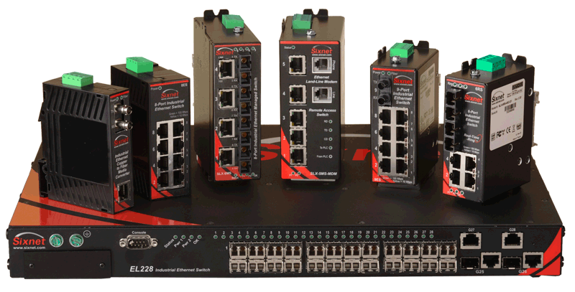
Sixnet Industrial Ethernet Switches
Light Industrial
SL Series
Standard Industrial
SLX Series
EB PoE Switch
Advanced Industrial
EL Platform
Specialty Industrial
Military
IP67 Industrial
OEM (Board Level)

Slide 50
Switch Positioning – the most asked question...
How do I decide “which to pitch”?
N-Tron
Sixnet SLX/EL Series
Who determines the answer?
The customer (with “sales guided” direction!)
How is the answer determined?
Requirements of the application (features, specs, regulatory certs)
Preferences of the user/purchaser (history with brands)
Availability of the configuration (port type and count)

Slide 51
Unmanaged Models
Common Features
Dual Power inputs
Plug and Play
Wide temp / shock and Vibration
Key Differentiators
N-Tron – Wider portfolio (fiber ports and total port count)
Sixnet – Varied mounting options
N-Tron – Monitored models (300-N)
Sixnet – Plug and play ring models with Modbus monitoring
Sixnet – ATEX certification
N-Tron – Shock and Vibration specs.

Slide 52
Managed Models – N-Tron
Key Differentiators
N-View Monitoring – now viewable on Crimson 3 products
Auto IGMP for Factory Automation integration
N-Ring for 30 ms recovery – 250+ nodes!
N-Link for linked ring redundancy
CIP messaging
Rapid boot up and link times

Slide 53
Managed Models – Sixnet SLX
Key Differentiators
Modbus monitoring registers for port, power, and ring status
Real Time Ring (RTR) supports mixed media rings (fiber and copper)
RTR supports multi-ring member (up to 4 per switch)
Units are IPv6 addressable
Flexible mounting options
ATEX, ABS, DNV, and Nema TS2 certifications (Some N-Tron models also have some of these certifications)

Slide 54
Managed Models – Sixnet EL 2xx/3xx
Key Differentiators
IEC61850/IEEE1613 Certification
Per port configuration (SFP based units) EL2xx
802.1x (Radius and TACACS+ based) security
Enterprise feature set, including advanced security
Layer 3 functionality (EL326)
Stacking function (virtual on EL2xx, physical on EL326)
10G options (EL326)

Slide 55
Switch Positioning
N-Tron Strengths | Sixnet SLX Strengths | Sixnet EL Strengths
N-Ring and N-Link | Real Time Ring | 61850/1613 (EL2xx)
N-View Monitoring | Modbus Monitoring | Advanced feature set Security protocols
CIP messaging | Mounting options/size | Per port configuration
Auto IGMP | Entry (SL) models | Layer 3 capabilities (EL326)
Broad unmanaged options – Made in USA
Boot up time | IPv6 addressable | Security (802.1x)
Shock and Vibration Specs. | Certs. (ATEX) | Advanced DHCP Server (EL326)

Slide 56
Where is the market headed?

Slide 57
Market Forecast
Unmanaged ASP = $272
Source: VDC Research 2011
Managed ASP = $1228

Slide 58
The move to Managed Switches
The need for monitoring
Redundancy
Multicast control (IGMP
VLANs – logical isolation of networks
Security features

Slide 61
What are our customers asking for?
Higher port count switches
More fiber connectivity
Gigabit capability
AC and DC power options
Advanced security features
IEEE1588
Managed Power over Ethernet / PoE+

Slide 62
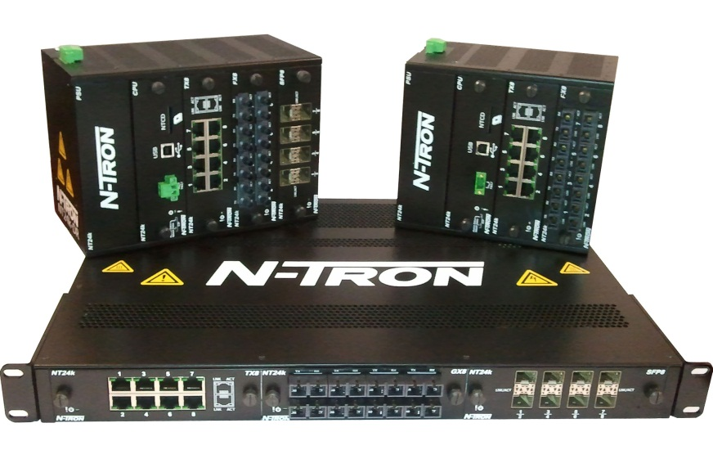
What are we doing about it?
Red Lion’s N-Tron NT24k
Modular Gigabit Managed Ethernet Industrial Switch Series

Slide 63
Red Lion N-Tron NT24k Switches
Managed Gigabit Ethernet Industrial Switch Series
All Gigabit design with copper and fiber options
Available in 3 models
NT24k rackmount
NT24k-DR24 DIN rail mount
NT24k-DR16 DIN rail mount
N-Tron NT24k Switches The Ultimate in Network Flexibility

Slide 64
Red Lion NT24k Feature Highlights
All Gigabit design with copper and fiber options
AC and DC power options
100Base SFP support (in addition to Gigabit)
Jumbo frame support
Hot swappable, auto-detecting modules
More flexible and powerful foundation for future expansion

Slide 65
Red Lion NT24k Feature Highlights
Support for N-Ring and RSTP concurrently on the same switch
Selectable N-Ring port pairs regardless of media
Telnet
HTTP file transfer
Full Human Readable Configuration (XML)
Recovery device provides full configuration backup and restore
SNMP v3 – more robust config/status implementation
Support of multiple concurrent trunks
Browser configuration over USB via PPP

Slide 66
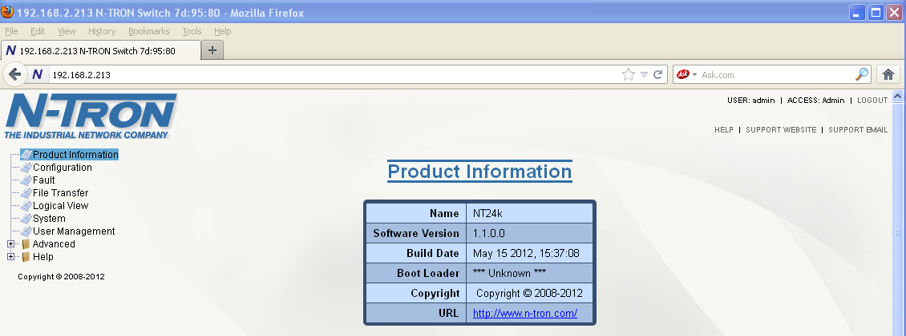
User Friendly Web Browser
Improved layout with user friendly help
Advanced port filtering capability
All ports
Installed ports
Linked ports
Installed modules

Slide 67
Red Lion NT24k Power Input Options
Redundant 18-49VDC
90-264VAC; 90-300VDC

Slide 68
Red Lion NT24k Module Options
TX8 – 8 10/100/1000BaseT Copper Ports
GX8 – 8 1000Base Fiber Ports
Multimode (550m)
Singlemode (10, 40, or 80km)
SC Style connectors
FX8 – 8 100Base Fiber Ports
Multimode (2km)
Singlemode (15, 40, 80km)
SC or ST style connectors
SFP8 – Supports Gigabit SFP transceivers
SFP-DM8 – Supports 100Base or 1000Base SFP transceivers

Slide 69
NT24k Series Rackmount Models
MODEL: NT24k Rackmount
-40° to 85°C operating temp
FCC, CE and UL approved
Available in 5 base configurations
NT24k-DC1 | Managed industrial Ethernet switch; 1U rack mount design with 3 modular expansion slots; with 1 redundant 18-49VDC power input
NT24k-DC2 | Managed industrial Ethernet switch; 1U rack mount design with 3 modular expansion slots; with 2 redundant 18-49VDC power inputs
NT24k-AC1 | Managed industrial Ethernet switch; 1U rack mount design with 3 modular expansion slots; with 1 90-264VAC/90-300VDC power input
NT24k-AC2 | Managed industrial Ethernet switch; 1U rack mount design with 3 modular expansion slots; with 2 90-264VAC/90-300VDC power inputs
NT24k-AC1-DC1 | Managed industrial Ethernet switch; 1U rack mount design with 3 modular expansion slots; with 1 90-264VAC/90-300VDC power input and 1 redundant 18-49VDC power input

Slide 70
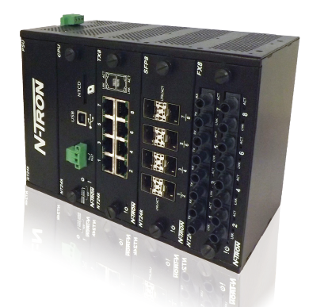
NT24k DIN Rail Models
MODEL: NT24k-DR24 DIN Rail
Up to 24 ports
-40° to 75°C operating temp
FCC, CE and UL approved
Available in 2 configurations
NT24k-DR24-DC | Managed industrial Ethernet switch; modular DIN-rail design with 3 expansion slots; 1 redundant 18-49VDC power input
NT24k-DR24-AC | Managed industrial Ethernet switch; modular DIN-rail design with 3 expansion slots; 1 90-264VAC / 90-300VDC power input

Slide 71
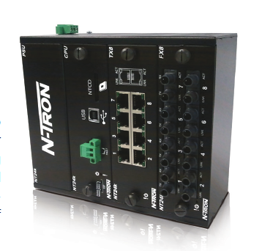
NT24k DIN Rail Models
MODEL: NT24k-DR16 DIN Rail
Up to 16 ports
-40° to 75°C operating temp
FCC, CE and UL approved
Available in 2 configurations
NT24k-DR16-DC | Managed industrial Ethernet switch; modular DIN-rail design with 2 expansion slots; 1 redundant 18-49VDC power input
NT24k-DR16-AC | Managed industrial Ethernet switch; modular DIN-rail design with 2 expansion slots; 1 90-264VAC / 90-300VDC power input

Slide 72
NT24k Future Release
Further enhancements will be made available in future releases:
N-Link
LLDP
CIP
DHCP Server
MAC address security
Browser logical view
N-View 64 bit OS support
IEEE 1588

Slide 73
Competitive Positioning

Slide 74
NT24k vs. Hirschmann MAR1040
Hardware Feature | NT24k | Hirschmann MAR1040
Port type and quantity | 16 Gigabit ports, Modular | 16
MAC addresses | 16K | 8K
MTBF | >1M hours | 244K hours
Operating Temperature | -40º to 85ºC | 0º to 60ºC
Enclosure | Metal | Metal
Redundant Power Inputs | Yes | Yes
Power options | Low voltage 18-49VDC High Voltage 90-300VDC or 90-264VAC | 24/36/49 VDC or 110/250VDC 110/230VAC
Surge protection diodes on power inputs | Yes | No
Degree of Protection | IP20 | IP30
Shock | 50g @ 10ms | 15g @ 11 ms
Vibration | 30g, 10-200G Hz, triaxial | 1g, 9-150 Hz
Price | $4997* | $5387 (INS)
*Configured with two TX8 modules
Model used for comparison is MAR1040-4C4C4C4C9999SLLHP

Slide 75
NT24k vs. Moxa IKS-G6524
Hardware Feature | NT24k | Moxa IKS-G6524
Port type and quantity | 24 Gigabit ports, Modular | 24 Gigabit ports, SFP
MAC addresses | 16K | 16k
MTBF | 2M hours | 282K hours
Operating Temperature | -40º to 85ºC | 0º to 60ºC Std. -40°to 75°C Ext. Temp.
Enclosure | Metal | Metal
Redundant Power Inputs | Yes | Yes
Power options | Low voltage 18-49VDC High Voltage 90-300VDC or 90-264VAC | 110-220VAC
Surge protection diodes on power inputs | Yes | No
Degree of Protection | IP20 | IP30
Shock | 50g @ 10ms | IEC 60068-2-27
Vibration | 30g, 10-200G Hz, triaxial | IEC 60068-2-32
Price | $8396 | $8959 (Neteon)
NT24k configuration has 4 more TX and 4 less SFP MM
Moxa has 20 SFP combo ports, 20 SFP 500m

Slide 76
NT24K N-Ring Demo

Slide 77
NT24k Key Selling Points
Red Lion N-Tron NT24k Series
Managed Gigabit Ethernet Industrial Switches
Configuration Flexibility
All Gigabit modular design
Copper and fiber options
Up to 24 port connections
Rackmount and DIN rail models
Maximum Performance
Extreme environments
Robust remote monitoring
Smart plug and play operation
N-Tron NT24k Switches The Ultimate in Network Flexibility

Slide 78
NT24k Key Selling Points
Why?
The NT24k Series was introduced to address the market need for modular industrial switches that provide higher port counts and varying media configuration, with smart plug-and-play operation.
Who?
The NT24k target customer needs an industrial-grade managed Ethernet switch with higher port count capability and increased fiber optic and/or Gigabit connectivity options.
Where?
The NT24k series delivers configuration flexibility that meets industrial networking requirements across industries including factory automation, utilities, video surveillance, security, transportation and alternative energy.

